Slide 1
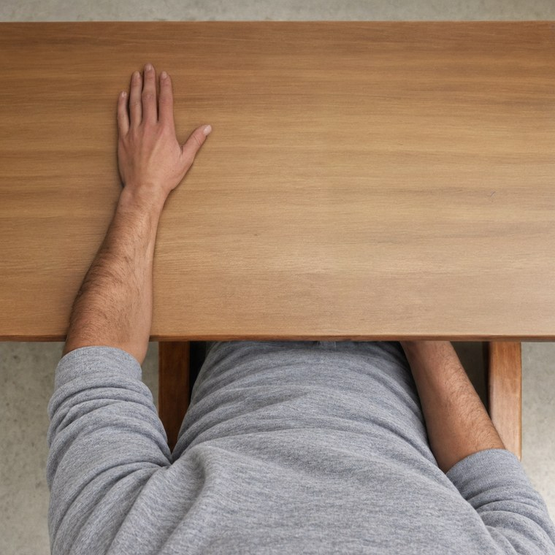
Does seeing a connected body change what a motor model does?
TRDP study: progress report
From generating the images to the trained spiking networks, and what comes next
Muhammed Emre Candir
Work recorded up to 26 October 2026
Notes:
Say who you are and what this talk is: a progress report on the TRDP study. In one sentence: we ask whether a computer model that only sees images can show the same motor response that people show when they watch a hand connected to a body. Earlier note: This deck replaces the earlier presentations and the October project guide. It tells the story in order: the question, the images, the human target, the image-only baselines, the model, the training campaign, where we stand now.

Slide 2
The project in one line: images in, motor response out, compared with humans
The general picture
1 · 11–22 Oct
2 · 22 Oct
3 · 23–24 Oct
4 · 24–26 Oct
5 · 4–18 Dec
Images
Human target
Gate 1
Model
Gate 2, evaluation
480 image families, plus silhouettes and controls
Paper’s data re-analysed; analysis rules frozen
Do images alone give the human pattern? No
Spiking network built; 2,400 networks trained
One held-out test against the human result
Done
Done
Done
Done
Next
Where we are: the model is trained, but it has not yet been tested on held-out images. So this deck contains no model result on the human pattern.
Terms: Gate = a planned checkpoint in the project. Held-out = images kept aside and never used in training. Spiking network = a model whose neurons communicate with brief pulses.
Notes:
Read the five boxes from left to right: images, human target, Gate 1, model, then the final test. Four steps are done and one is next. Then read the blue box slowly: the model is trained, but we have no result yet on whether it matches humans. Earlier note: Give this slide first so the supervisor always knows where each later slide sits. The most important sentence is the blue box: everything about the model so far is health checks on training data.

Slide 3
Short forms from the human experiment
The general picture · Word list 1
Short form | Full name | In simple words
TMS | Transcranial magnetic stimulation | A magnetic pulse to the motor cortex
MEP | Motor evoked potential | The muscle’s response to that pulse
FDI | First dorsal interosseous | The muscle that moves the index finger
ADM | Abductor digiti minimi | The muscle that moves the little finger
FB, UL, DH | Full body, upper limb, detached hand | The paper’s three displays
VR | Virtual reality | Scenes seen through a headset
SD | Standard deviation | The typical spread of values
CI | Confidence interval | The likely range of the true value
OSF | Open Science Framework | A public data website
These short forms are also explained at the bottom of the slides that use them.
Notes:
Do not read this table. Say that the talk uses a few short forms, and that each slide explains its own at the bottom. The four to remember are TMS, the pulse; MEP, the muscle response; FDI, the index-finger muscle; and ADM, the little-finger muscle.

Slide 4
Short forms from the images and the model
The general picture · Word list 2
Short form | Full name | In simple words
SDXL | Stable Diffusion XL | An AI image generator
SAM-HQ | Segment Anything Model, High Quality | Finds the outline of an object
DINOv2 | Self-distillation with no labels, version 2 | A ready-made vision model
OpenCLIP | Open version of CLIP (Contrastive Language-Image Pre-training) | A ready-made vision model
LIF | Leaky integrate-and-fire | A simple neuron that sums input and fires
H0, H1, H2, H4 | Hypotheses 0, 1, 2 and 4 | Competing rules tested in the model
P1–P3, S1–S3 | Our pass criteria | Main tests and supporting tests
AUC | Area under the curve | Task score: 0.5 is chance, 1 is perfect
GPU | Graphics processing unit | The chip used to train the networks
These short forms are also explained at the bottom of the slides that use them.
Notes:
Same idea: this is a reference list and you can go back to it if a term comes up. Most of these are tools. The important ones for the story are the vision models, DINOv2 and OpenCLIP, and the hypotheses H0, H1 and H2.

Slide 5
The question
Section 1
The reference study · Its three displays · One trial · What humans show · What we ask
Notes:
This section explains the human experiment we start from and the question we ask. Keep it short: the paper, its three displays, one trial, its result, our question.

Slide 6
We start from a human experiment on body continuity
The question · Reference study
Matamala-Gomez, Frisco et al. (2025), Scientific Reports 15:13364
32
3
People in VR watch a left hand; the index finger either stays still or moves.
The hand appears with more or less of a body attached.
A magnetic pulse (TMS) tests the motor cortex while they watch.
The muscle response to the pulse (MEP) is recorded from two hand muscles.
participants
body displays
60
2
trials per block: 30 static, 30 movement
muscles: FDI (index), ADM (little finger)
Terms: VR = virtual reality. TMS = transcranial magnetic stimulation, a magnetic pulse to the motor cortex. MEP = motor evoked potential, the muscle’s response to the pulse. FDI = first dorsal interosseous, the muscle that moves the index finger. ADM = abductor digiti minimi, the muscle that moves the little finger.
Source: reference paper, Methods; analysis spec §2
Notes:
Explain the experiment as a story. People wear a headset and watch a hand. The index finger stays still or moves. While they watch, a magnetic pulse is given to the motor part of the brain, and we measure how strongly the hand muscle answers. A bigger answer means the motor system is more ready. The numbers on the right give the size of the study. Earlier note: FDI is the muscle that abducts the index finger, so it is the muscle the observed action concerns. ADM is the comparison muscle.

Slide 7
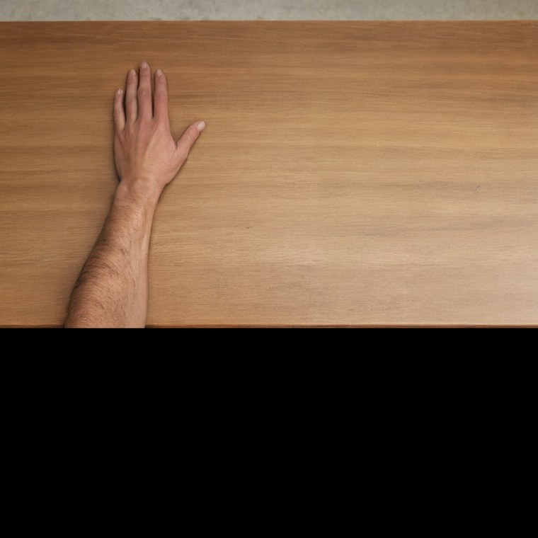
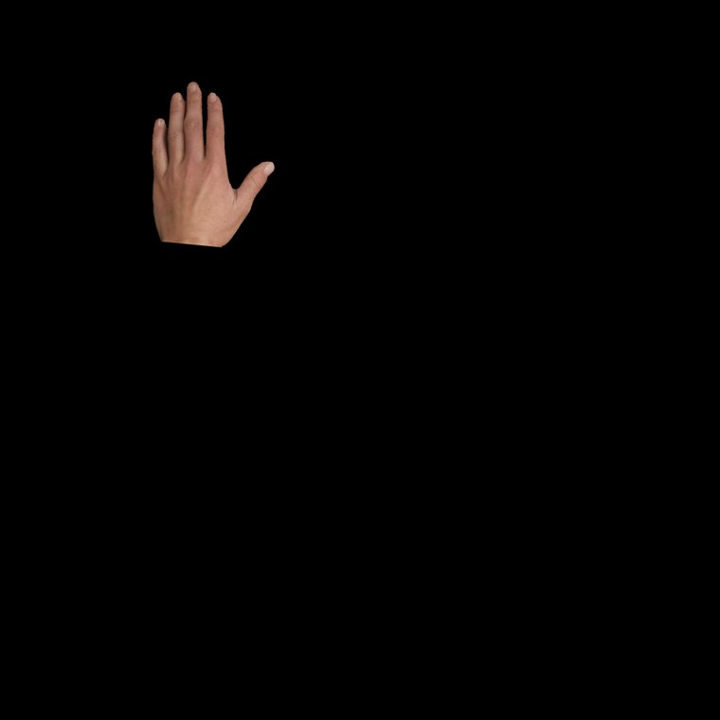
The same hand, with less and less body connected to it
The question · Three displays
Full body (FB)
Upper limb (UL)
Detached hand (DH)
The whole first-person scene: arm, torso, legs.
The arm on the table, cut off from the body.
An isolated hand on black, cut at the wrist.
Terms: Synthetic = made by AI, not photographed. VR = virtual reality. FB, UL, DH = short names for the three displays.
Images are our synthetic versions of the paper’s displays, which were 360° and 180° VR photographs. Spec §2
Notes:
Show the three pictures from left to right. It is the same hand each time, but less and less body is connected to it: whole scene, arm only, then hand only. This is the only thing that changes between the displays. Earlier note: Important honest point: these are flat synthetic images, not the authors' VR stimuli. The differences are listed in analysis spec section 2.

Slide 8
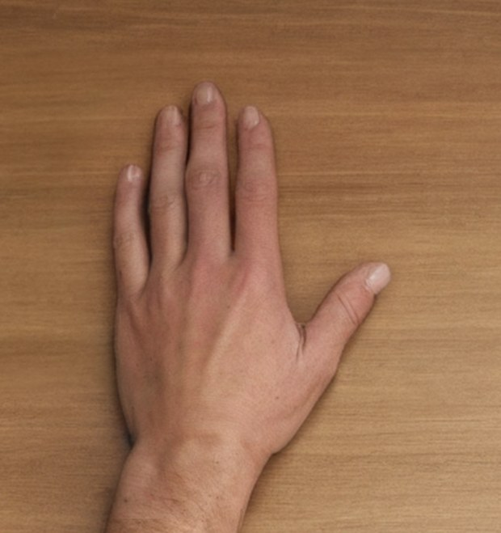
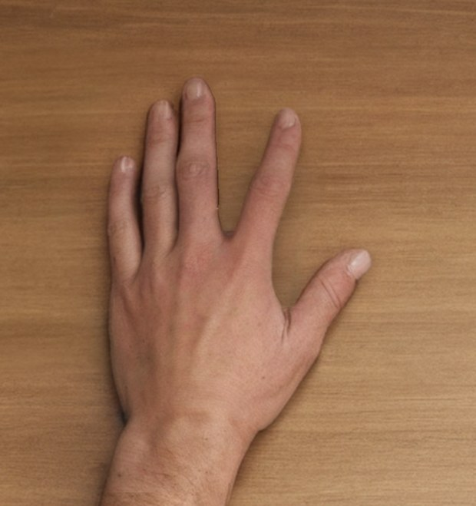
Each trial shows two frames, and a pulse tests the motor system
The question · One trial
First frame: static hand, 2,250–3,250 ms
250 ms
500 ms
Second frame, 750 ms. Pulse (TMS) at 250 ms, at 120% of the resting threshold
Static trial: A then A
Movement trial: A then B
MEP measured: size of the muscle response, 5–60 ms after the pulse
Participants’ task: count the finger movements
Frame A: static
Frame B: index moved away
Terms: TMS = transcranial magnetic stimulation, a magnetic pulse to the motor cortex. MEP = motor evoked potential, the muscle’s response to the pulse. Resting threshold = the weakest pulse that gives a response at rest. Frame = one image.
Source: reference paper, Methods; analysis spec §2. Hand images are ours (reference 12).
Notes:
Follow the timeline bar from left to right. First a still hand. Then a second image: the same image on a static trial, or the moved finger on a movement trial. The pulse comes 250 milliseconds into the second image. Then compare the muscle response between movement and static trials. Participants simply count the finger movements.

Slide 9
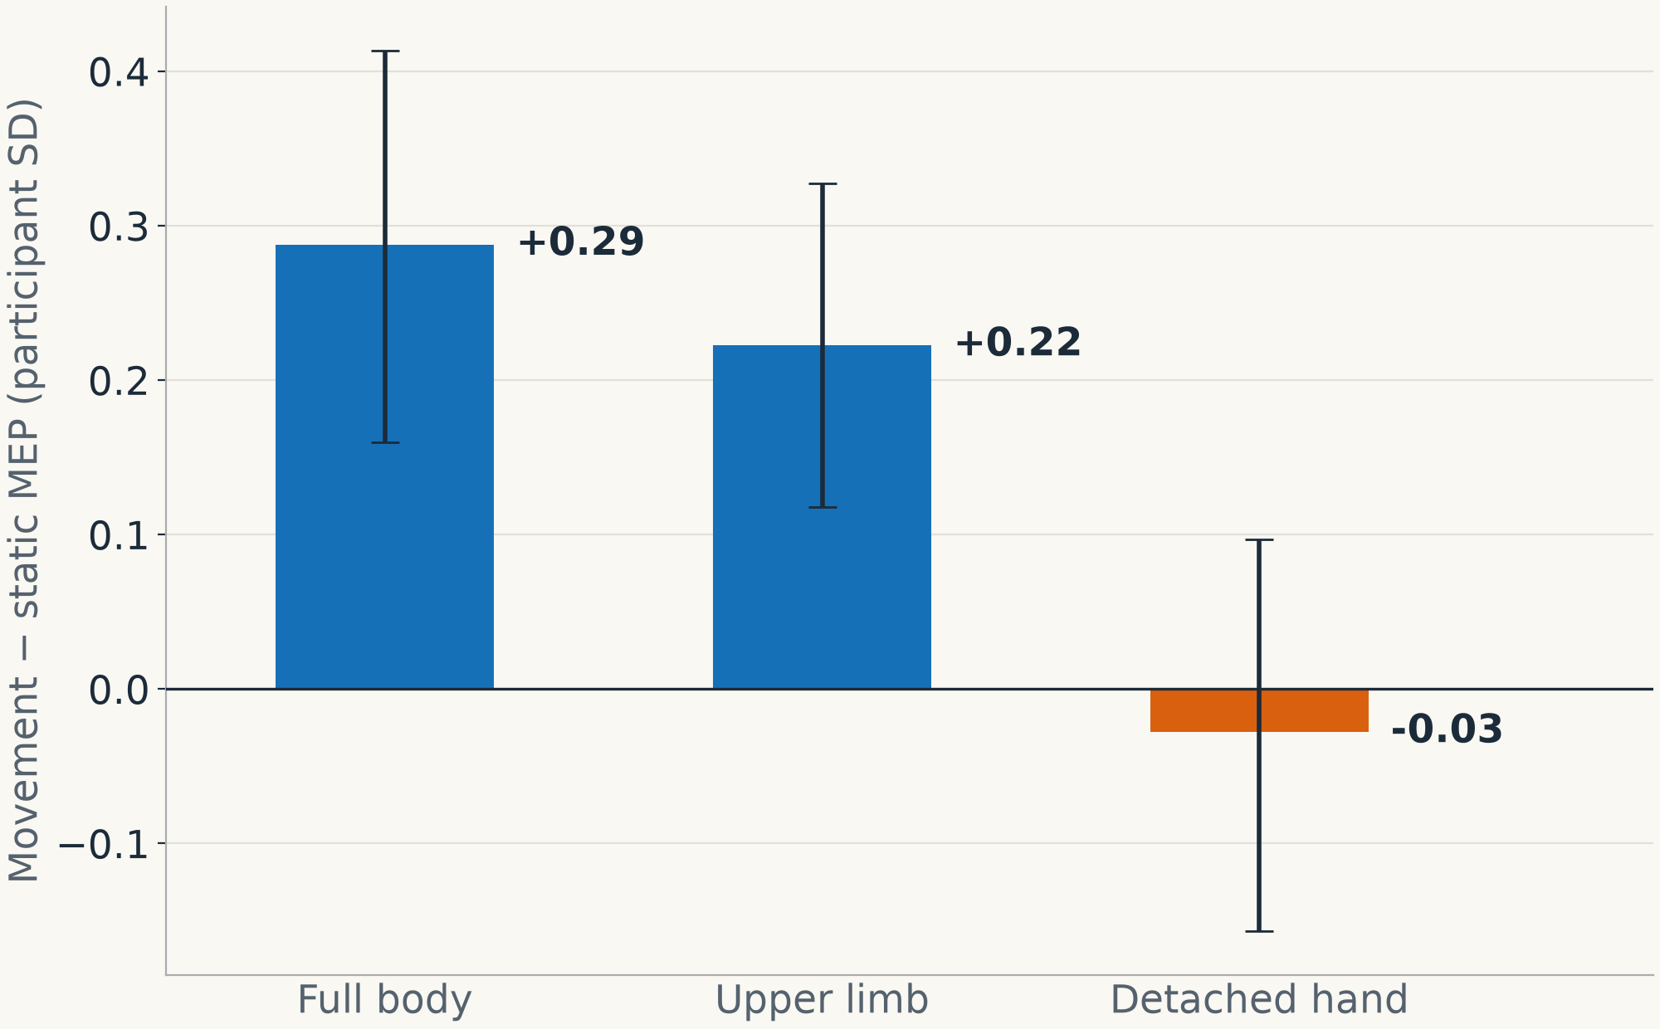
In humans, the motor response grows for a connected hand, not a detached one
The question · Human result
Facilitation = the index-muscle (FDI) response is larger when the finger moves than when it stays still.
It appears in full body and upper limb. No effect is detected in the detached hand.
Bars: mean of 32 participants. Whiskers: the likely range of the true value (95%).
Terms: FDI = first dorsal interosseous, the muscle that moves the index finger. MEP = motor evoked potential, the muscle’s response to the pulse. SD = standard deviation, the typical spread. OSF = Open Science Framework, a public data website.
Source: our participant-level re-analysis of the paper’s OSF data (Section 3); analysis spec §4.5
Notes:
This is the key human result and the target for the whole project. When the finger moves, the index muscle responds more, but only when the hand is connected to an arm or a body. For the detached hand, no effect is detected. Note that no effect detected does not prove the effect is exactly zero. Earlier note: This is the pattern the whole project is trying to explain. Values are in participant standard deviations, the z-normalisation the paper's Methods describe.

Slide 10
Can a model that only sees images reproduce this pattern?
The question · What we ask
The model receives only images of the three displays, with the paper’s trial timing. Does it facilitate for full body and upper limb, and not for the detached hand?
What we may claim
What we may not claim
Whether our specified model shows the human pattern on images it never trained on
Which model parts are necessary for that
Replication of the human experiment
Ownership or agency: the model has no such variable
That the model’s readout is the same as a real muscle response (MEP)
Generalisation beyond the 20 source hands
Terms: MEP = motor evoked potential, the muscle’s response to the pulse. Facilitate = respond more strongly to movement than to a still hand. Held-out = kept aside, never used in training.
Source: analysis spec §1
Notes:
State the question in the blue box. Then be clear about the limits. A positive result would show that this model can produce the pattern, and which of its parts are needed. It would not replicate the human experiment, and it would not say anything about feelings of ownership or agency, because the model has no such thing.

Slide 11
The images
Section 2
A. Creating 20 source pairs · B. Expanding to 480 families · C. Checks and known issues · D. Silhouette and control displays
Notes:
This section shows how the images were made, step by step. A source pair means one still image and one moved image of the same hand. First we make 20 good pairs, then we vary their appearance to get 480 families, then we check them and add the control displays.

Slide 12
The final image set, in numbers
The images · Overview
20
480
2,880
+960
approved source pairs (static + movement)
families: same hand and movement, different look
images in the accepted archive
silhouette images made from the same pixels
Action
Format
The real sample size
The left index moves away by 10.5–24.7° (median 18.3°)
Colour images, 2048 × 2048 pixels; hidden areas are black
20 movements. Desk, seed and colour tone only add variety.
Terms: Source pair = one still and one moved image of one hand. Family = one hand and movement with one look. Seed = a number that fixes the random part of generation. Silhouette = only the hand’s skin, on black.
Source: README; next-phase plan §1; analysis spec §3
Notes:
Give the four numbers: 20 pairs, 480 families, 2,880 images, plus 960 silhouettes. Then the most important point: there are really only 20 different movements. The rest is variety in appearance, so we never count 480 as the sample size. Earlier note: Stress the last point. 480 families does not mean 480 independent samples. Every analysis treats the source, 20 groups, as the unit.

Slide 13
Two stages: make good source pairs, then vary their appearance
The images · Overview
A. Create 20 source pairs
1 Reference pair
2 Generate the scene
3 Separate hand and desk
4 Repair the hand
5 Move the index by image geometry
6 Repair the finger edge
7 Correct the clothing
8 Human approval (V7)
B. Expand to 480 families, with the movement untouched
1 Protect hand and body with masks
2 Generate a new desk, share it in A and B
3 Apply three colour tones
4 Export the displays, verify, review
Terms: V7 = version 7 of the source images. Mask = a map of which pixels may change. Colour tone = white balance: neutral, warm or cool.
Source: project guide, 11 October 2026. All following examples show reference 12 unless noted.
Notes:
This is the map for the next slides. Stage A has eight steps and creates the 20 source pairs. Stage B has four steps and only changes the desk and colour, so the hand movement stays untouched. Every following slide shows one of these steps, using reference 12 as the example.

Slide 14
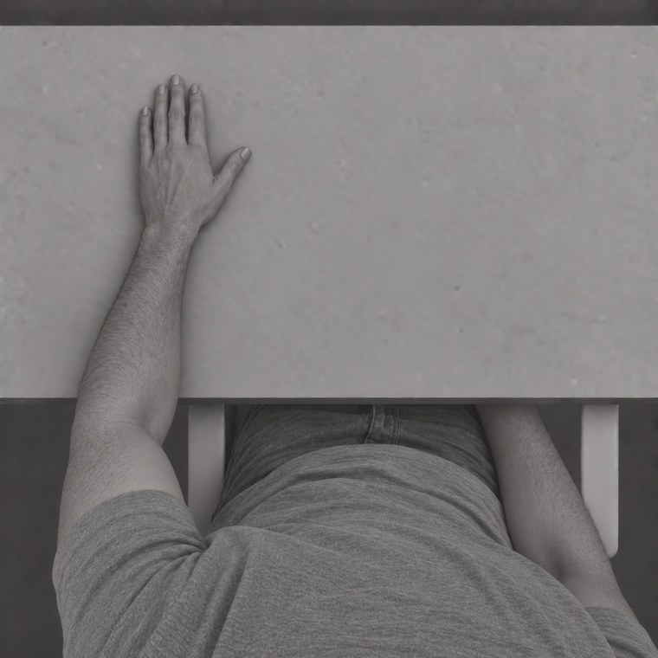
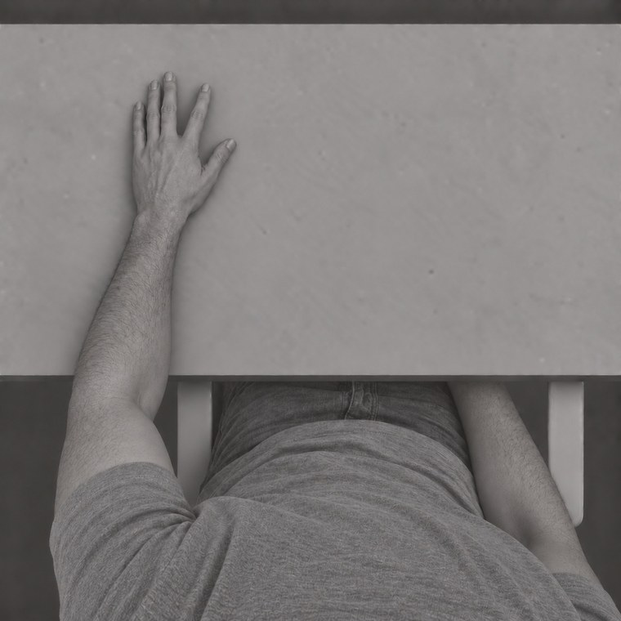
Start from a grayscale reference pair
The images · A. Source pairs · Step 1 of 8
20 AI-generated reference pairs, showing 20 different synthetic people.
The static image gives the scene layout.
The pair gives the target opening: 18.37° for reference 12.
Static reference
Movement reference
Terms: Grayscale = black and white. Reference pair = the starting still and moved images. Target opening = how far the index must move.
Source: project guide p. 2; analysis spec §3
Notes:
We start from a simple black-and-white pair: a still hand and a moved hand. We use the still image for the layout of the scene, and the pair tells us how far the finger should open. For reference 12 that is 18.37 degrees.

Slide 15
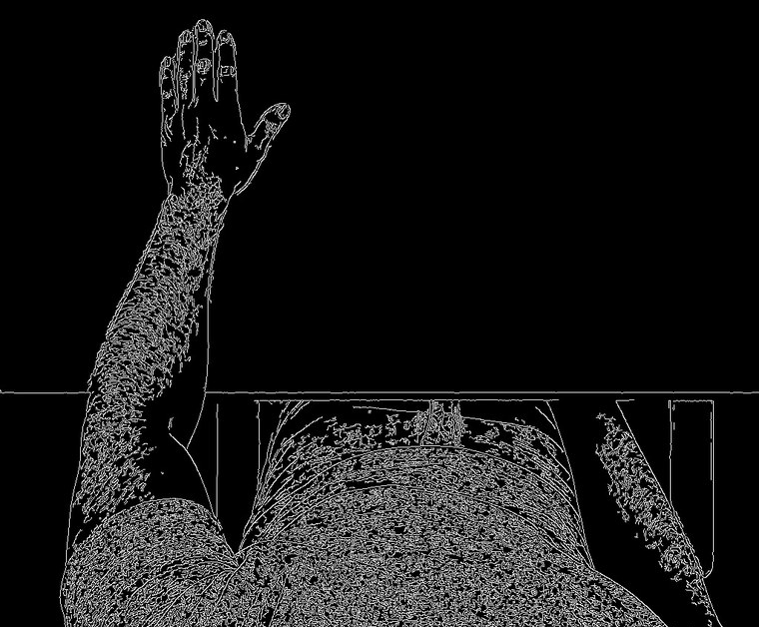
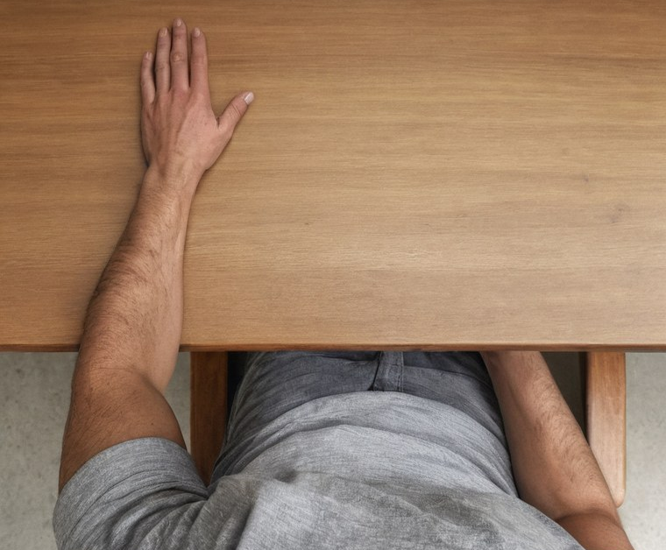
Generate one photorealistic scene, guided by edges
The images · A. Source pairs · Step 2 of 8
Input: static reference
Guide: Canny edges
Output: one generated scene
Only one scene is generated: making both frames separately would change unrelated details. Models: RealVisXL V4.0 with a Canny ControlNet.
Terms: RealVisXL = a photorealistic version of SDXL (Stable Diffusion XL, an AI image generator). ControlNet = an add-on that makes the generator follow a guide. Canny = a method that draws an image’s edges.
Source: project guide pp. 2–3
Notes:
Left to right: the black-and-white image, its edges, and the realistic scene the generator made by following those edges. We generate only one scene on purpose. If we generated two images, many things would differ, not only the finger.

Slide 16
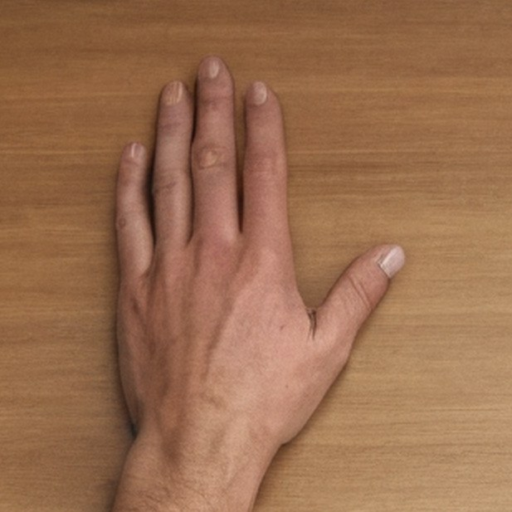
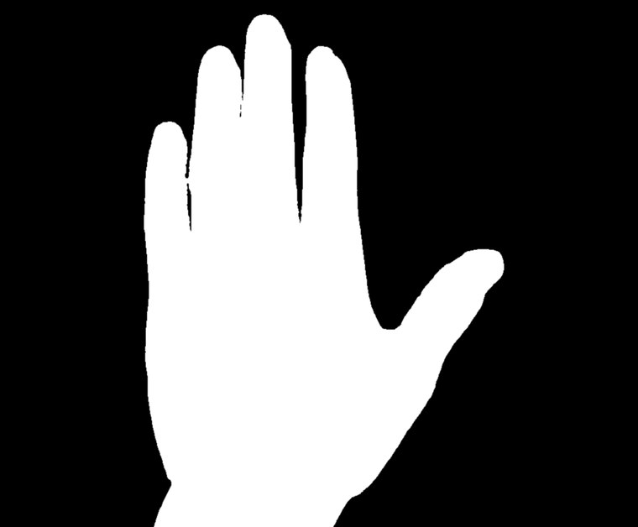
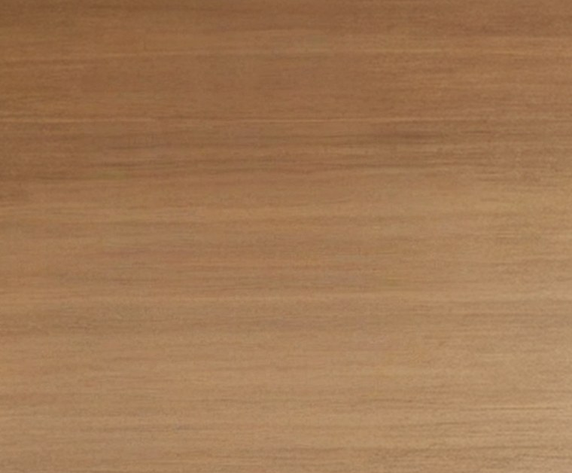
Separate the hand from the desk
The images · A. Source pairs · Step 3 of 8
Input: hand area
Hand matte: which pixels are hand
Empty desk plate
Why: the empty desk fills the gap when the finger moves away. Tools: SAM-HQ with checked corrections for the matte; ObjectClear for the desk.
Terms: Matte = a black-and-white map of the hand’s pixels. SAM-HQ = Segment Anything Model, High Quality, which finds object outlines. ObjectClear = an AI tool that removes an object. Plate = the background alone.
Source: project guide p. 4
Notes:
We split the picture into two layers: the hand, and the desk without the hand. We need the empty desk because when the finger moves, something has to appear in the place it left.

Slide 17
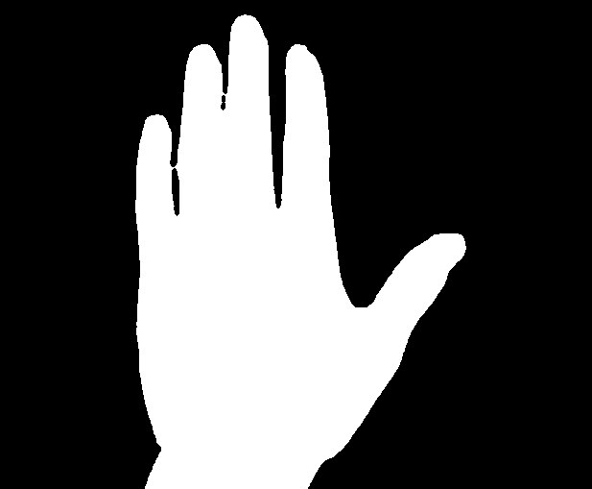
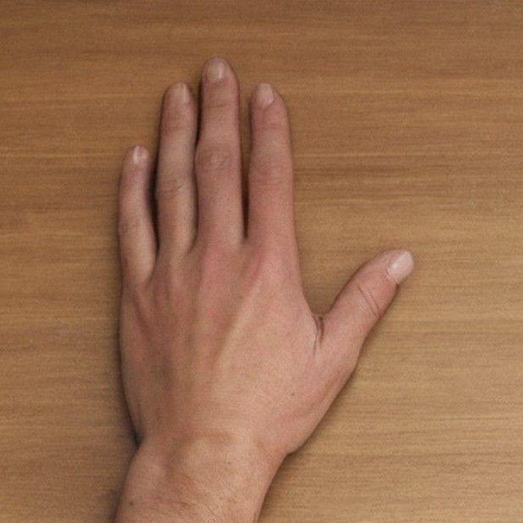
Repair the hand once, then reuse it in both frames
The images · A. Source pairs · Step 4 of 8
Before: generated hand
Mask: white may change
After: shared hand repair
Nails and skin texture are fixed only inside the white mask (version V5). Pixels changed outside the mask: 0.
Terms: Mask = a map of which pixels may change. Inpainting = AI regenerates only the masked area. V5 = version 5 of the source images.
Source: project guide p. 5
Notes:
AI-generated hands often have poor nails and skin, so we repair them once. The mask says where changes are allowed. We then checked: not one pixel changed outside it. The same repaired hand is used in both frames, so the repair cannot create a false difference between them.

Slide 18
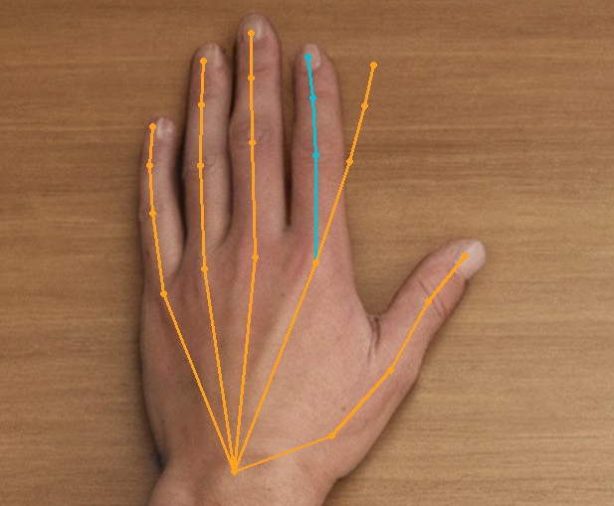
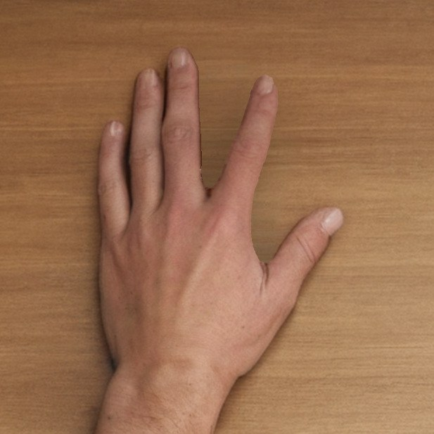
Build the movement by geometry, not by generation
The images · A. Source pairs · Step 5 of 8
Input: repaired hand
Geometry: only the index moves
Output: first movement frame
The upper index rotates around its base by 18.37°, and a smooth mesh joins it to the still palm. Limit: this is a flat image edit, not a true 3D rotation.
Terms: Landmarks = points marking the hand’s joints. Mesh = a grid that lets the image stretch smoothly. Geometry = moving pixels by calculation, without AI generation.
Source: project guide p. 6
Notes:
This is an important choice. We did not ask the AI to draw a moved finger, because it would change other things too. Instead we rotate the index by calculation, so only the finger moves. Mention the limit honestly: it is a flat image edit, not a real 3D movement.

Slide 19


Repair only the edge of the moved finger
The images · A. Source pairs · Step 6 of 8
Before: from geometry
Mask: finger edge and root only
After: selected movement
The other fingers stay locked, so static and movement frames differ only around the index. Pixels changed outside the mask: 0.
Terms: Mask = a map of which pixels may change. Web = the skin between the fingers. Root = the base of the finger.
Source: project guide p. 7
Notes:
The rotation leaves small marks around the finger. We repair only that small area with AI. The check is the same as before: zero pixels changed outside the mask, so the two frames differ only around the index.

Slide 20

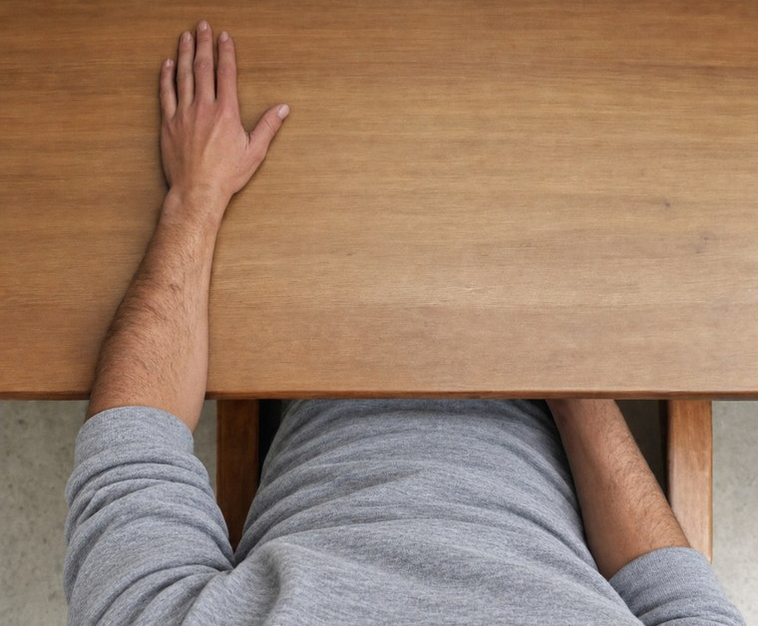
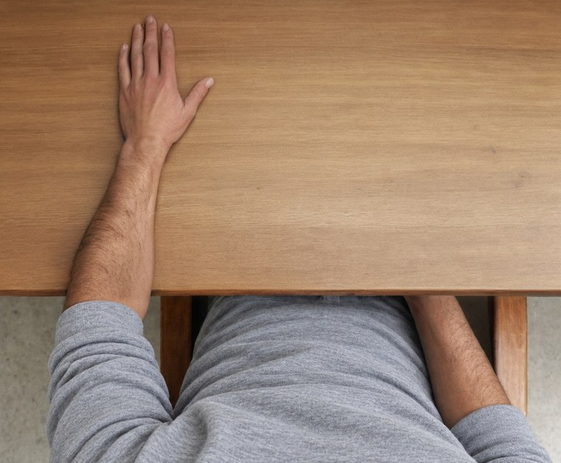
Make the torso and sleeves one coherent garment
The images · A. Source pairs · Step 7 of 8
Before: mismatched clothing
Proposal: one edit of torso and sleeves
After: lower scene only is replaced
Pixels changed in the hand area: 0 (version V6). Limit: the image editor did not show its seed or model version, so this step cannot be re-run exactly.
Terms: V6 = version 6 of the source images. Seed = a number that fixes the random part of generation. Garment = the clothing.
Source: project guide p. 8
Notes:
In some images the torso and sleeves did not look like the same piece of clothing, so we corrected them with an image editor. The hand was not touched. The limit is reproducibility: the editor did not show its settings, so we keep the saved images but cannot re-create them exactly.

Slide 21
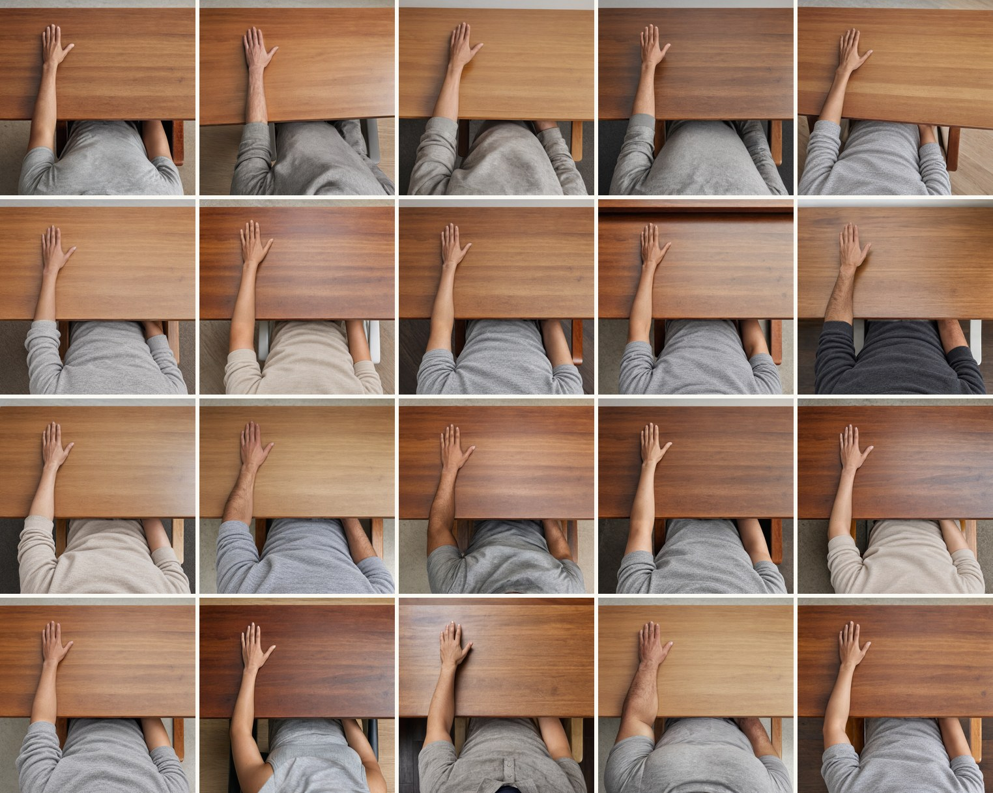
All 20 source pairs are approved and frozen as V7
The images · A. Source pairs · Step 8 of 8
20 synthetic people: their reference labels are 10 female and 10 male.
Last fix: in reference 2 the moved index looked bent, so the original finger was rigidly rotated instead.
Frozen: 220 files (120 source images and 100 inputs) with recorded hashes, so any altered file is rejected.
Terms: V7 = version 7, the final source images. Hash = a digital fingerprint of a file. Frozen = no longer allowed to change.
Source: project guide pp. 9–10; validation; next-phase plan §3
Notes:
All 20 pairs were approved by a person. From this point the files are locked: each has a digital fingerprint, and any changed file is rejected. The last correction was in reference 2, where the moved finger looked bent, so the original finger was rotated rigidly instead.

Slide 22
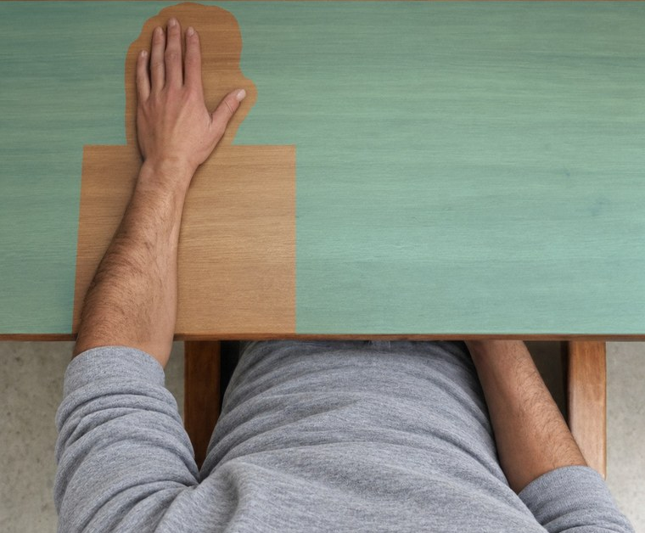
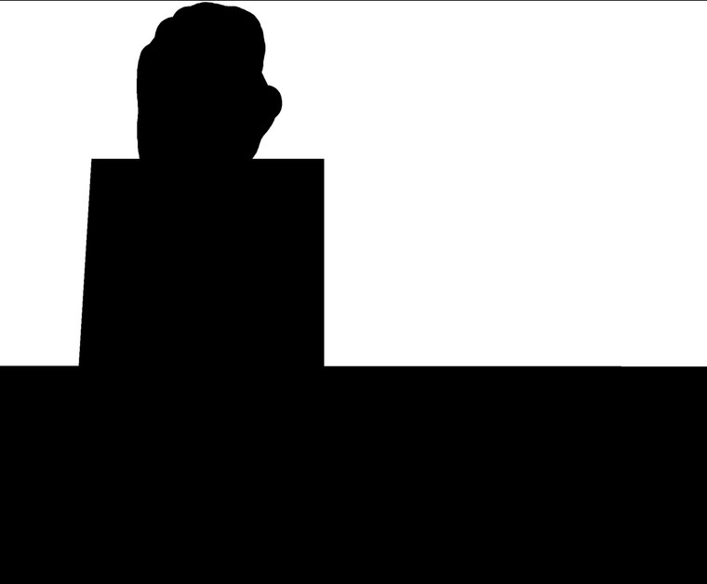

Masks decide what may change: only the desk
The images · B. Expansion · Step 1 of 4
Overlay: cyan is editable
Mask: black is protected
Soft edge: 48-pixel fade, close-up
The mask protects the hand in both frames, every pixel that differs between A and B, the forearm and the body. The fade hides the boundary of the new desk.
Terms: Mask = a map of which pixels may change. Overlay = the mask drawn over the picture. Frames A and B = the still and the moved image.
Shown: the corrected mask. The accepted archive used an earlier mask (see “Known issues”). Source: project guide pp. 11–13
Notes:
Now we start stage B: changing the look without touching the movement. The mask allows changes only on the desk. The hand, the forearm, the body and every pixel that differs between the frames stay protected. The soft fade hides the border of the new desk.

Slide 23
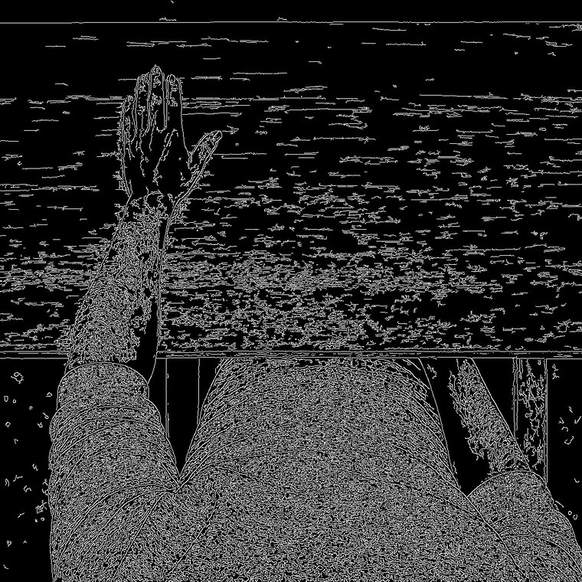

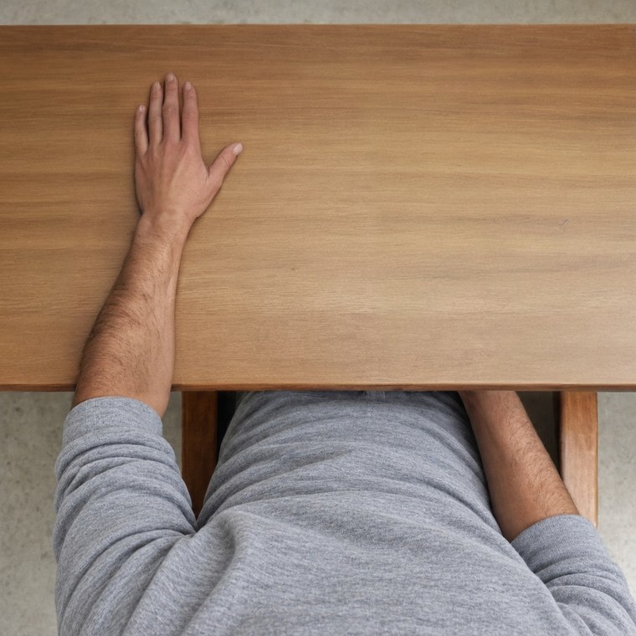

Generate a new desk and share it between A and B
The images · B. Expansion · Step 2 of 4
1. Guide: saved Canny edges
2. Proposal: raw output, not a stimulus
3. Frame A: source + desk pixels
4. Frame B: source + the same desk pixels
Only permitted desk pixels enter the final images. Because both frames get the same desk, the movement stays the only difference between them.
Terms: Canny = a method that draws an image’s edges. Proposal = the generator’s raw image. Seed = a number that fixes the random part of generation. Frames A and B = the still and the moved image.
Example: reference 12, birch desk, seed 9. Source: project guide pp. 14–15
Notes:
The generator proposes a new desk, but we copy only the allowed desk pixels into the final images. The key point is the bold sentence: both frames get exactly the same desk, so the movement remains the only difference between them.

Slide 24
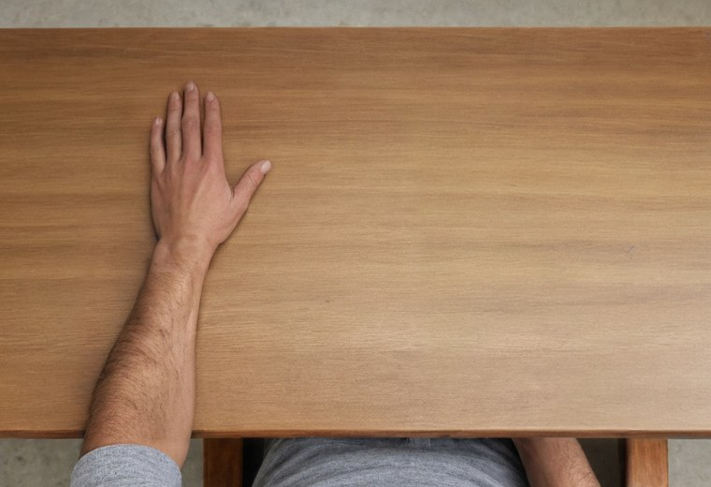
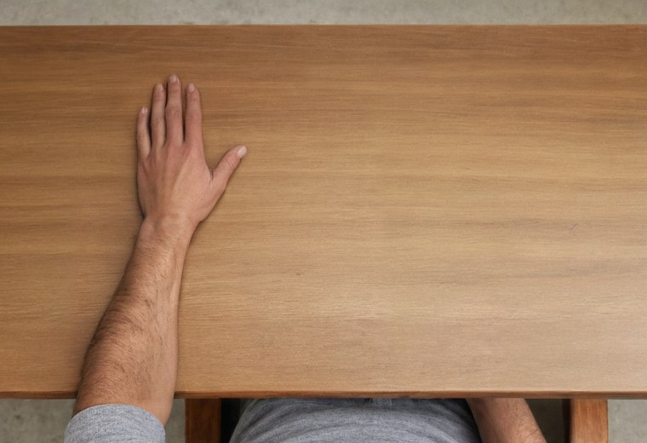

Make three colour tones from each pair
The images · B. Expansion · Step 3 of 4
Neutral
R, G, B gains 1.0, 1.0, 1.0
Warm
R, G, B gains 1.035, 1.0, 0.965
Cool
R, G, B gains 0.965, 1.0, 1.035
A fixed colour change, applied identically to both frames. Nothing new is generated. These are not new lighting or new people.
Terms: White balance = the colour tone of an image. R, G, B gains = how much red, green and blue are multiplied. Frames = the still and the moved image.
Previews are cropped to show the desk. Source: project guide p. 16
Notes:
This is the simplest step. We multiply the red, green and blue values by fixed numbers to make a neutral, a warm and a cool version. It only changes colour tone. It does not create new lighting or new people.

Slide 25
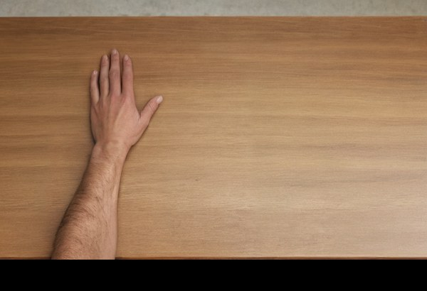
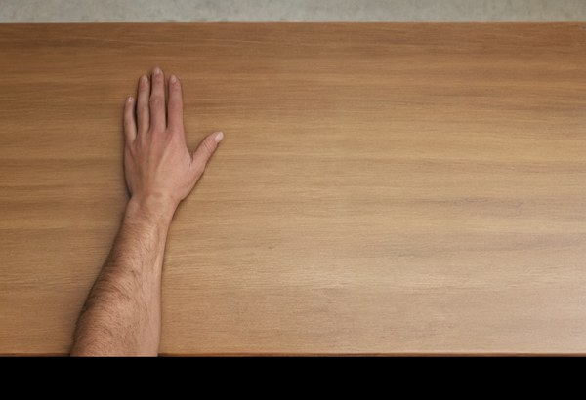


How 20 pairs become 480 families and 2,880 images
The images · B. Expansion · Step 4 of 4
20
4
2
3
480
6
×
×
×
=
×
sources
desks
seeds
balances
families
images
Beech
Oak
Maple
Birch
Each family has 3 displays × 2 frames. They are paired views of one hand, not independent samples.
Terms: Source = one hand and movement. Seed = a number that fixes the random part of generation. Balance = colour tone. Display = full body, upper limb or detached hand. Frame = still or moved.
Source: project guide p. 18
Notes:
Read the multiplication: 20 sources, 4 desks, 2 seeds, 3 colour tones give 480 families. Each family has 6 images: 3 displays, each in 2 frames. That gives 2,880 images. Remind them that these are views of the same hands, not independent samples.

Slide 26
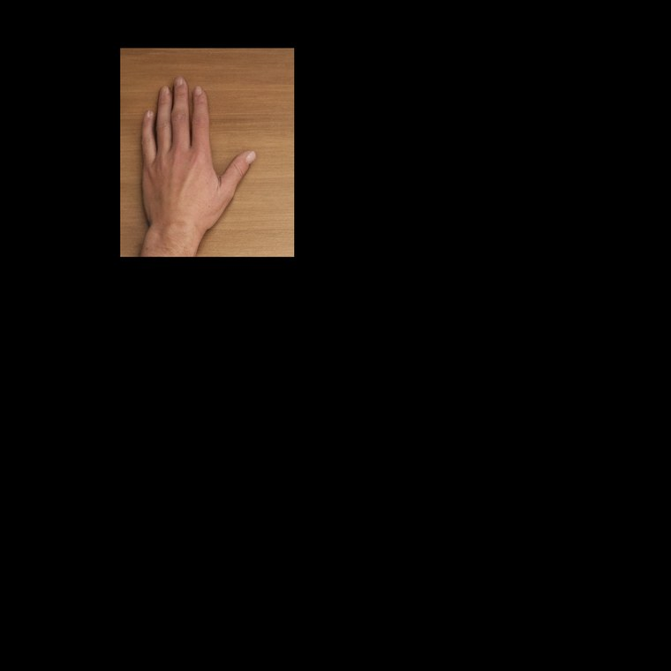



One family: six images, always in the same position
The images · B. Expansion · Result
Full body
Upper limb
Detached hand
Hand position and size never change between displays. Hidden areas are black.
Static
This original detached hand keeps a desk patch. It was later replaced as the primary display (see “Silhouette”).
Movement
Terms: Family = one hand and movement with one look. Seed = a number that fixes the random part of generation. Static = still finger. Movement = moved finger.
Family r12_birch_s9_warm: reference 12, birch desk, seed 9, warm tone. Source: project guide p. 17
Notes:
This shows one complete family. Look across a row: the hand stays in exactly the same place and size, and only what is visible around it changes. Look down a column: only the finger changes. Note that this detached hand still shows a piece of desk, which we later replaced.

Slide 27
The archive was verified by code and accepted by eye
The images · C. Checks
Check | Result
Families and image hashes | 480 unique families, all 2,880 hashes match
Protected pixels (original masks) | 0 errors
Differences between A and B | Stay inside the movement area
Hidden areas | Black everywhere they should be
Worked example (reference 12) | Rebuilding the images matches the saved ones exactly
Copy on the CREMI machines | 5,276 files hash-identical; checks reproduced
Visual acceptance | All 480 families accepted, 11 October 2026
Code checks integrity, not realism. Only a human decision can approve how an image looks.
Terms: Hash = a digital fingerprint of a file. CREMI = the University of Bordeaux lab computers. Archive = the accepted set of images. Frames A and B = still and moved.
Source: validation (11 and 23 October); approval receipt
Notes:
We checked the images in two ways. Code checks that files are complete, unchanged, and that only the allowed pixels differ. Code cannot judge whether a hand looks realistic, so a person accepted all 480 families by eye on 11 October.

Slide 28
Four known issues, each measured and recorded
The images · C. Known issues
Earlier desk mask
Reference 17 clothing
It reached slightly into the hand in 144 of 480 families: at most 0.65% of the visible hand, at most 6 of 255 brightness levels, identical in both frames.
An accepted clothing issue, flagged in its 24 families.
Decision: keep, and repeat every result without it (456 families).
Decision: keep all 480.
One unblinded reviewer
Synthetic hands
All images were accepted by one person who knew the hypothesis. A package for two independent raters was prepared but not run.
One generator, one scene template, one camera geometry.
Consequence: results apply at most to hands of this kind in this setup.
Decision: report it as a limitation.
Terms: Unblinded = knew what the study expects. Rater = a person who judges the images. Family = one hand and movement with one look. Mask = a map of which pixels may change.
Source: validation; analysis spec §3; decision audit §2
Notes:
Say these openly. One: an earlier mask touched the hand very slightly, but the change is tiny and the same in both frames, so we kept the images. Two: reference 17 has a clothing issue, so every result is repeated without it. Three: only one person, who knew the hypothesis, reviewed the images. Four: all hands come from one generator and one setup, which limits how far results apply. Earlier note: Rater validation: recruiting naive raters was judged not feasible, decision of 24 October. A corrected mask exists in the code for any future generation, but the accepted images were kept unchanged.

Slide 29
This method was chosen after testing alternatives
The images · C. Earlier attempts
Tried | What we saw
Unguided generation | Hands and layout were unreliable, so guided SDXL became the base
Other guides | Pose and segmentation unreliable; soft edges weakened boundaries; Canny kept
Other image models | Several compared; RealVisXL V4 fitted our photorealism needs best
FoundHand (AI reposing) | Changed nails, bend and shading, and did not open the index enough
Qwen (AI image editor) | Ran out of memory or gave noisy gray images in the settings tried
Desk regenerated from noise | Invented gray material, boxes or tools
Many image-warping methods | Some passed numerically but still showed visual problems
A rejected setting does not prove a method can never work. It only did not work here.
Terms: SDXL = Stable Diffusion XL, an AI image generator. Canny = a method that draws an image’s edges. Pose, segmentation, soft edges = other types of guide. Warping = stretching pixels by calculation.
Source: project guide pp. 21–23
Notes:
No need to read every line. The message is that the method was not the first idea: we tried simpler routes and they failed in visible ways. Add the last sentence: a method that failed here is not proven useless in general.

Slide 30
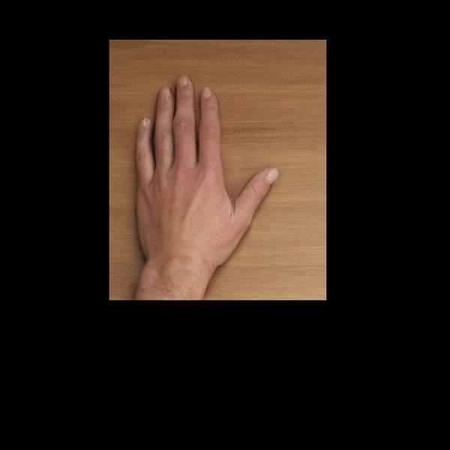
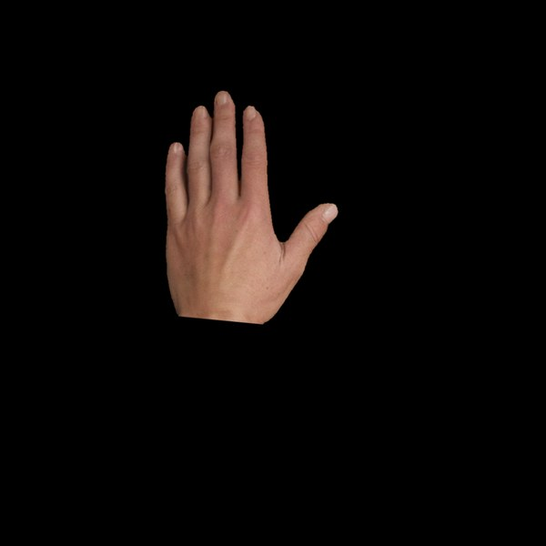
The detached hand now matches the paper: skin only, on black
The images · D. Silhouette
Why: the paper’s hand had no surface, shadow or arm. The rectangle keeps a desk patch, shadows and part of the wrist.
How: SAM-HQ finds the hand, then a straight cut at the wrist.
Checked: 960 images recomputed exactly from full-body pixels. Approved 22 October.
Rectangle
Now a secondary check
Silhouette
Now the main display
Terms: SAM-HQ = Segment Anything Model, High Quality, which finds object outlines. Silhouette = only the hand’s skin, on black. Rectangle = the earlier detached hand with a piece of desk.
Source: detached-hand silhouette document; validation
Notes:
We noticed that our earlier detached hand was not like the paper’s: it kept a piece of desk, shadows and part of the wrist. So we made a new one with only the hand on black, and this is now the main detached hand. We kept the rectangle as a secondary check. It is made from the same pixels and was approved on 22 October.

Slide 31
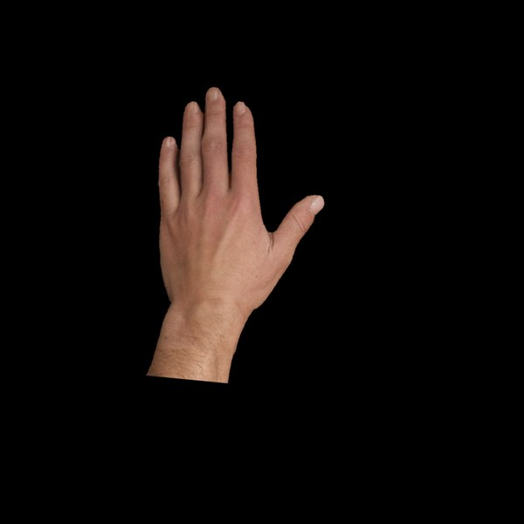
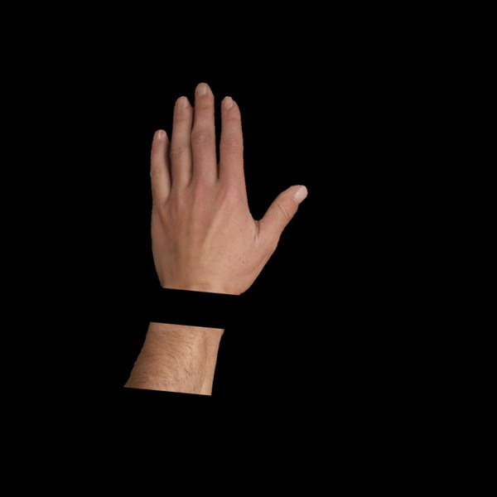
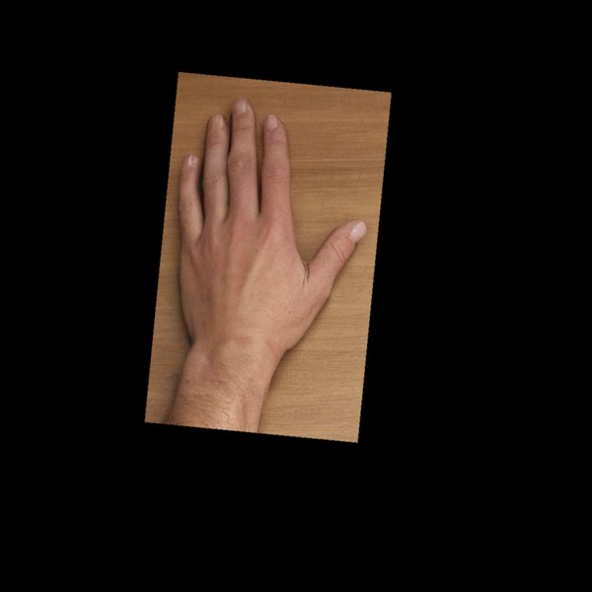
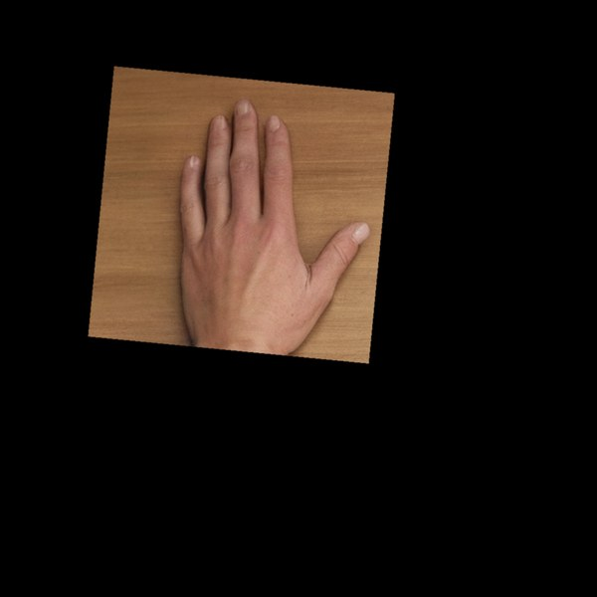
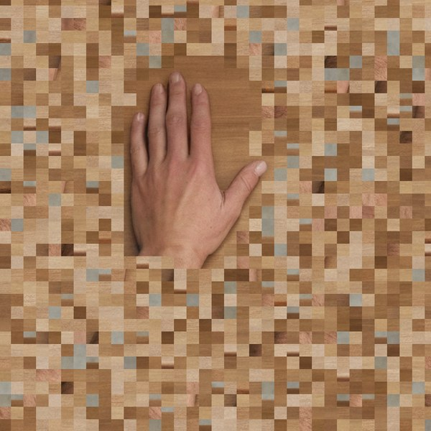
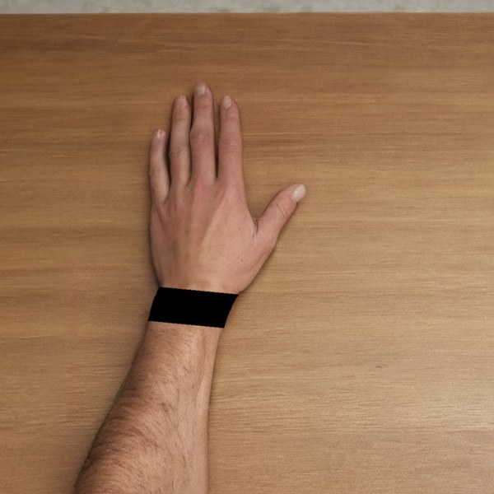
Six control displays test “connected” versus “how much is visible”
The images · D. Controls
Hand stub
Gap stub
Arm window
Hand window
Scrambled
Occluded wrist
Hand + 1 palm width of forearm
Same area, wrist missing
Window extends down the arm
Same area, sideways over desk
Same pixels, arm scattered
Band over the wrist (extra test)
Why they are needed: in the paper’s displays, connection and visible context change together. Here the hand and its movement stay identical; only the surroundings change.
No human data exist for these displays. They test model predictions only.
Terms: Stub = a short piece of forearm. Window = a rectangle showing the scene. Control = a display that tests one explanation. Extra test = no prediction declared.
Cropped around the hand. Approved 22 October. Source: controls document; analysis spec §7.2
Notes:
Here is the problem: in the paper, a hand with more arm also shows more of the image, so the two explanations are mixed. These new displays pull them apart. For example, the hand stub and the gap stub show the same amount of image, but only one is connected. There are no human data for them, so they only test the model.

Slide 32
Each pair has the same area, brightness and movement size
The images · D. Matched pairs
Display | Visible area | Brightness | Moving share
Hand stub (connected) | 2.61% | 0.014 | 25.2%
Gap stub (disconnected) | 2.62% | 0.014 | 25.1%
Arm window (connected) | 5.77% | 0.027 | 18.5%
Hand window (disconnected) | 5.77% | 0.026 | 18.5%
So if the model treats the two displays of a pair differently, the reason is not area, brightness or movement size. It is connection, or something not matched, such as shape.
Terms: Matched pair = one connected and one disconnected display, equal on these measures. Moving share = how much of the visible image changes. Source = one hand and movement.
Mean over the 20 sources. Source: controls document
Notes:
Compare the rows in each coloured group: the numbers are almost the same. That is the design. The limit is shape: for example, the two windows differ in shape, one taller and one wider, so we do not claim everything is matched.

Slide 33
The human target
Section 3
Re-analysing the paper’s data · Which effects are robust · The main number · Rules fixed before any model
Notes:
Before building a model we must know exactly what it should reproduce. So here we check the paper’s data ourselves, decide which effects are reliable, choose the main number, and fix the rules in advance.

Slide 34
We rebuilt the human result from the paper’s own data
The human target · Re-analysis
11,280
2.08%
18 / 18
MEPs in the paper’s OSF data, from 32 participants
missing (240 of 11,520), exactly as the paper reports
legible published statistics reproduced
Reproduced: Table 2 (8 of 8 values) and the follow-up tests in the Results (10 of 10).
What that means: our files and code match the published analysis. It does not mean we agree with that analysis.
Terms: MEP = motor evoked potential, the muscle’s response to the pulse. OSF = Open Science Framework, a public data website. Legible = readable in the paper.
Source: analysis spec §4.1; validation (22 October); output/human_target
Notes:
First we confirmed that we have the same data as the authors. We downloaded it and reproduced all 18 published values that are readable in the paper. This only shows the data and code match. It does not mean we accept their statistics, and the next slide explains why. Detail if asked: 93 MEPs below 50 microvolts are kept, and removed only in a sensitivity check.

Slide 35
We use participants, not single trials, as the unit
The human target · Statistics
The published tests
Our target
Used raw millivolts, although the Methods describe z-scores
About 11,000 single trials count as observations, which inflates the test values
One value per participant (32 values)
Compared within each person
Called robust only if it holds on 5 different scales
Example, little-finger muscle (ADM) in upper limb: the published test gives z = 4.67. At participant level it gives p = .07, which is not significant.
Terms: z-score = a value in units of spread. p = how surprising the result would be if there were no real effect. ADM = abductor digiti minimi, the muscle that moves the little finger. Robust = holds under every analysis choice.
Source: analysis spec §4.2–4.4; next-phase plan §1
Notes:
Explain it simply: 32 people took part, so we have 32 independent people, not 11,000 independent measurements. Counting single trials makes effects look stronger than they are. The little-finger example shows how much this matters. Detail if asked: the published model has only a participant random intercept, and the participant-level test is t(31) = 1.86. Earlier note: This is a discrepancy we report, not something we correct on the authors' behalf. Contacting the authors remains optional.

Slide 36
Three effects are robust; the detached hand shows no effect
The human target · Robust effects
Effect (movement − static) | Size [95% CI] | Verdict
Index muscle (FDI), full body | 0.288 [0.159, 0.413] | Robust
Index muscle (FDI), upper limb | 0.223 [0.118, 0.327] | Robust
CFDI: connected minus detached | 0.283 [0.147, 0.419] | Robust
Index muscle (FDI), detached hand | −0.028 [−0.157, 0.097] | No effect detected
Little-finger muscle (ADM), upper limb | 0.114 [0.014, 0.250] | Not robust
Muscle comparison: full body vs detached | 0.247 [0.078, 0.423] | Not robust
Full body minus upper limb | 0.065 [−0.133, 0.251] | No difference detected
So the model’s target is a larger index-muscle response for connected displays, and none for the detached hand. No detected effect is not proof of zero.
Terms: CI = confidence interval, the likely range of the true value. SD = standard deviation, the typical spread. CFDI = the contrast in the index muscle (FDI): connected minus detached. FDI = first dorsal interosseous, the muscle that moves the index finger. ADM = abductor digiti minimi, the muscle that moves the little finger.
Size in participant SD. Robust = significant after correcting for many tests, and the range excludes 0 on all 5 scales. Source: analysis spec §4.4
Notes:
The blue rows are what the model must reproduce: the index muscle responds more to movement in full body and in upper limb, and the difference between connected and detached is clear. The other rows did not survive our checks, so we do not ask the model to reproduce them. Details if asked, p values from top to bottom: .0001, .0003, .0003, .67, .07, .009 (.06 after Holm correction, a correction for many tests), .51.

Slide 37
One number sums up the human effect: CFDI
The human target · The main number
CFDI = [ Δ(full body) + Δ(upper limb) ] / 2 − Δ(detached hand)
Δ = index-muscle response to movement minus response to static
Positive means the connected displays increase the index-muscle response more than the detached hand does.
0.283
24/32
The same formula is applied to humans and to every model.
human value, likely range [0.147, 0.419]
participants with a positive value
Terms: CFDI = the contrast in the index muscle (FDI): connected minus detached. FDI = first dorsal interosseous, the muscle that moves the index finger. Δ = delta, a difference.
Units: participant SD (standard deviation). Source: analysis spec §4–5
Notes:
This is the main number of the project. In words: average the movement effect of the two connected displays, then subtract the movement effect of the detached hand. In humans it is 0.283, positive in 24 of 32 people. The same formula will be used for every model. Detail if asked: t(31) = 4.06, p = .0003.

Slide 38
The motor effect follows visible attachment more than reported ownership
The human target · Interpretation
Motor response (MEPs)
Ownership questionnaire
Full body ≈ upper limb > detached
Full body > upper limb ≈ detached
What this does not show: whether the cause is the connected arm or simply seeing more of the scene, because the two change together here.
That gap is why we built the control displays.
Terms: MEP = motor evoked potential, the muscle’s response to the pulse. Ownership = the feeling that the hand is your own. ≈ = about the same.
Source: analysis spec §1
Notes:
Compare the two boxes. The motor response is about the same for full body and upper limb. The ownership questionnaire is high only for full body. So the motor effect follows the visible attachment more closely than the reported feeling. But do not overclaim: human data cannot tell attachment from simply seeing more scene. Detail: we do not model the paper’s mediation analysis.

Slide 39
The analysis rules were frozen before any model result
The human target · Rules
22 Oct
Dated
Once
Rules frozen: the data, the measures, the 20 data splits and what counts as a pass
Any later change is recorded in a dated amendment log, with its reason
Held-out evaluation is opened one time only
This is like preregistration: it keeps planned tests apart from what we find after seeing results.
Terms: Preregistration = writing down the plan before seeing results. Held-out = kept aside, never used in training. Amendment log = a dated list of changes.
Source: analysis spec; Nosek et al. 2018
Notes:
We wrote the rules before any model result existed, so we cannot adjust them to get a good answer. If something must change, the change and its reason are recorded with a date. The final test on held-out images can be opened only once.

Slide 40
Gate 1: can vision alone explain it?
Section 4
The test · The result · Why it reverses · Zooming in · Can vision models see attachment?
Notes:
Before building a motor model, we test the simplest explanation: maybe the images alone already contain the human pattern. If they did, a motor model would explain nothing new.

Slide 41
Does a ready-made vision model already show the human pattern?
Gate 1 · The test
Movement signal = how much the image’s numbers change from frame A to frame B, compared with how much the 20 sources differ from each other.
What we compared
How
Simple image statistics
Pixels, shrunk to 64 × 64
DINOv2, read in two ways (summary and patch mean)
OpenCLIP
10,560 images
Method fixed before any number was computed
Uncertainty estimated over the 20 sources
No training: vision only
Terms: Encoder = a ready-made vision model that turns an image into a list of numbers. DINOv2, OpenCLIP = two such vision models. Frozen = used as is, not trained. Patch mean = the average over small image pieces. Frames = still and moved images.
Source: baselines document; validation
Notes:
The test is simple: show the still image and the moved image to a vision model, and measure how much its numbers change. A big change means a big movement signal. If it were bigger for connected displays than for the detached hand, images alone would explain the human pattern. Details: the models are DINOv2 ViT-L/14 and OpenCLIP ViT-bigG-14, where ViT means vision transformer.

Slide 42
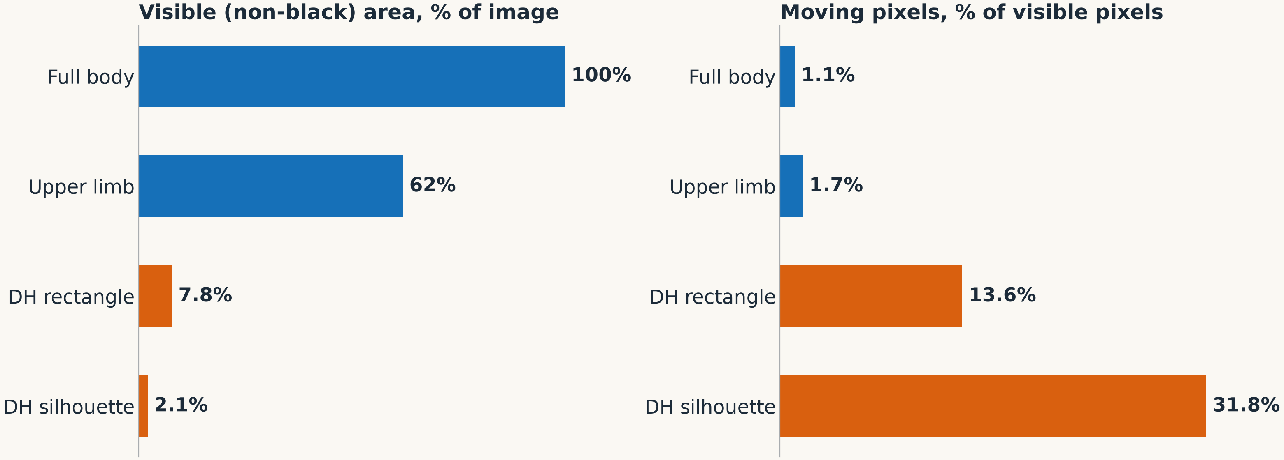
The less is visible, the larger the movement’s share of it
Gate 1 · What varies between displays
Terms: Rectangle = the earlier detached hand with a piece of desk. Silhouette = only the hand on black. Moving pixels = pixels that change between frames.
Measured on 80 families (seed 9, neutral tone). Source: output/baselines; baselines document
Notes:
Look at the two charts together. On the left, visible area falls from 100% to about 2%. On the right, the moving part grows from about 1% to about 32% of what is visible. So the less we show, the bigger the movement is within the picture. This matters for the next slide.

Slide 43
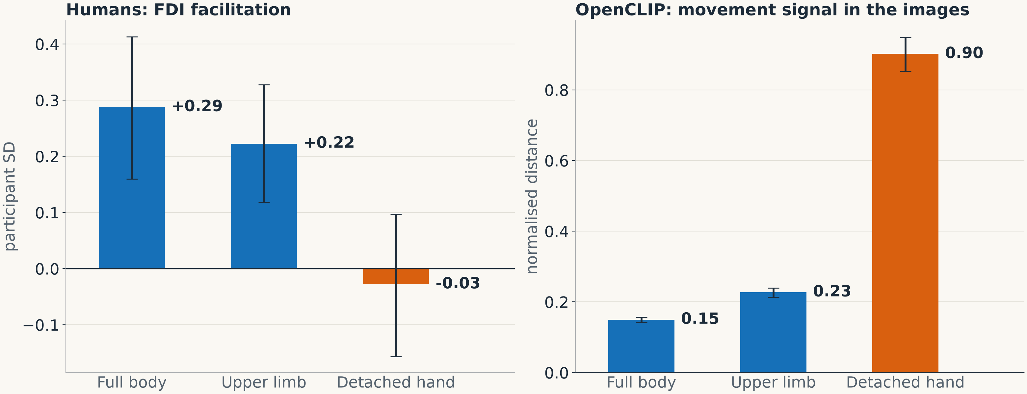
Vision models give the opposite pattern to humans
Gate 1 · The result
Terms: FDI = first dorsal interosseous, the muscle that moves the index finger. SD = standard deviation, the typical spread. OpenCLIP = a ready-made vision model. Facilitation = a larger response to movement. Movement signal = how much the model’s numbers change.
The panels have different units: compare the pattern, not the heights. Source: output/baselines; analysis spec §4
Notes:
This is the main result of Gate 1. Humans: strong for connected displays, nothing for the detached hand. Vision model: exactly the opposite, with the largest signal for the detached hand, 0.90, against 0.15 and 0.23. So the images alone do not give the human pattern. They point the other way.

Slide 44
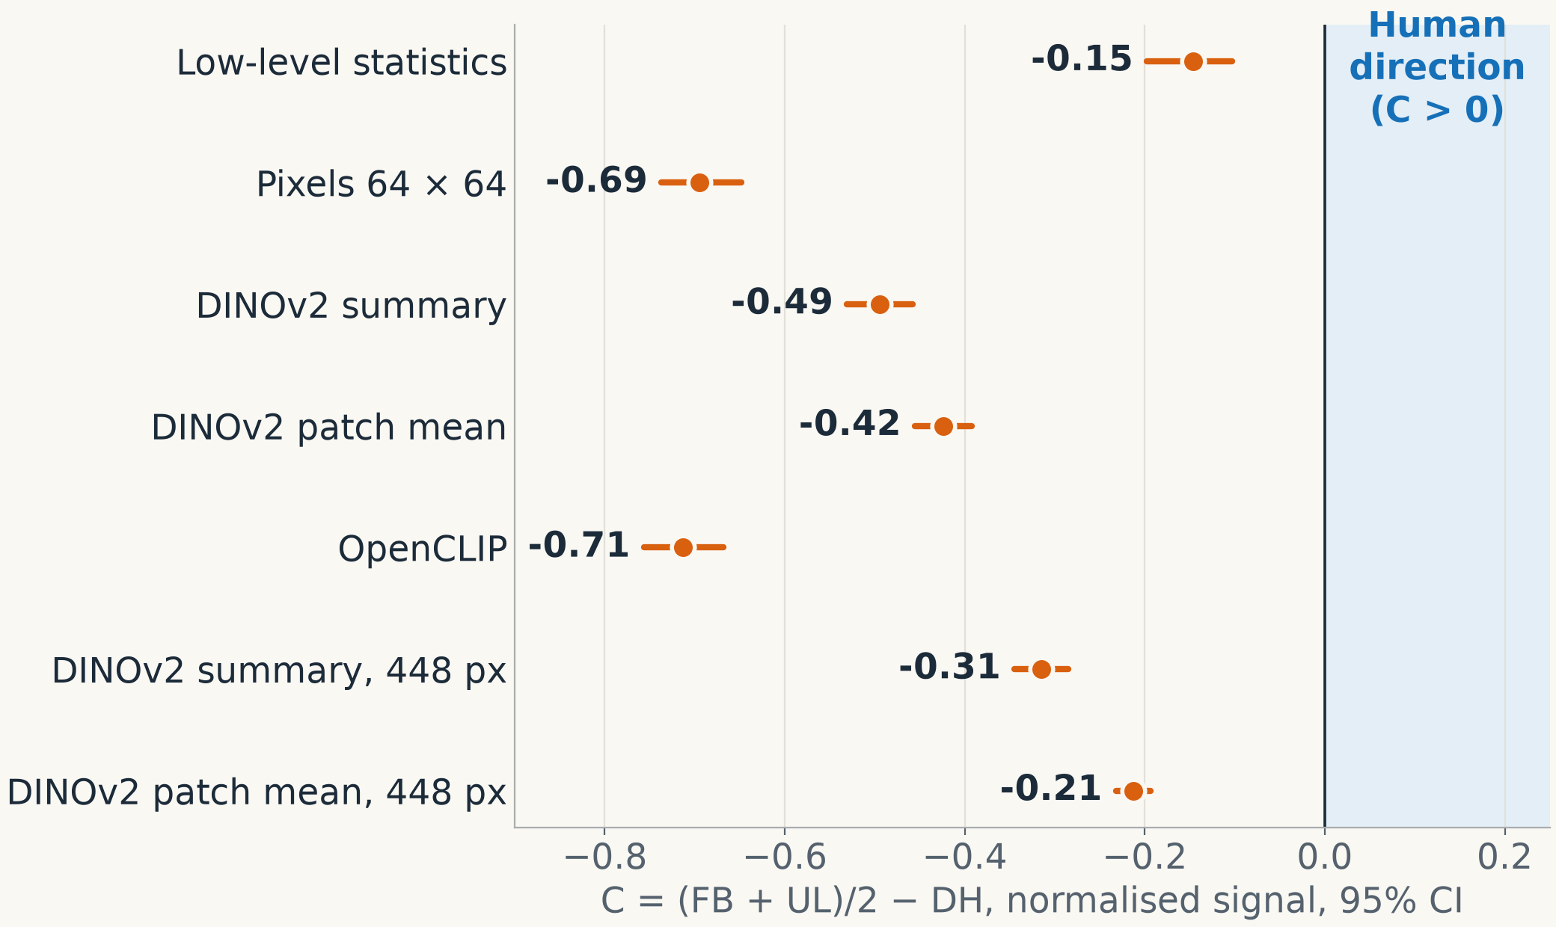
The reversal appears in every representation
Gate 1 · The result
0 / 20
sources go in the human direction
4–8 ×
detached signal vs connected; in humans the ratio is about −0.11
72 / 76
alternative analyses reversed, 4 unclear, none human
Terms: C = connected signal minus detached signal; above 0 is the human direction. CI = confidence interval, the likely range of the true value. DINOv2, OpenCLIP = two such vision models. Reversal = C below 0.
Hand-only input gives C = 0 by design, so it is not shown. Source: output/baselines; baselines document
Notes:
Each dot is one way of representing the images, and the line is its likely range. The blue area on the right is the human direction. Every dot is on the left, in the wrong direction. It does not depend on the model we choose. Details: the two lower rows repeat DINOv2 at 448 pixels, −0.315 and −0.213. The 72 of 76 counts sensitivity cells. With hand-only input, C is zero by construction.

Slide 45
On black, the same finger movement is a far bigger image change
Gate 1 · Why it reverses
Finger against the desk
Finger against black
0.078
0.242
average brightness change: full body, upper limb, rectangle and windows
about 3 × larger, and the change covers 29% of what is visible (1.1% in full body)
A useful check: the rectangle has the same pixel change as full body, so pixels give C exactly 0. The vision models still reverse there, so they react to more than pixel change.
Terms: C = connected signal minus detached signal; above 0 is the human direction. Rectangle = the detached hand with a piece of desk. Windows = rectangles showing the scene.
Source: baselines document
Notes:
A simple explanation. A skin-coloured finger moving over a desk changes the image a little. The same finger moving against black changes it a lot, because the contrast is much higher, and because little else is visible. So vision models see the biggest change for the detached hand. Details if asked: on the rectangle, the raw values are DINOv2 −4.28 and −1.89, and OpenCLIP −3.83. The share of visible pixels is 29% in the silhouette.

Slide 46
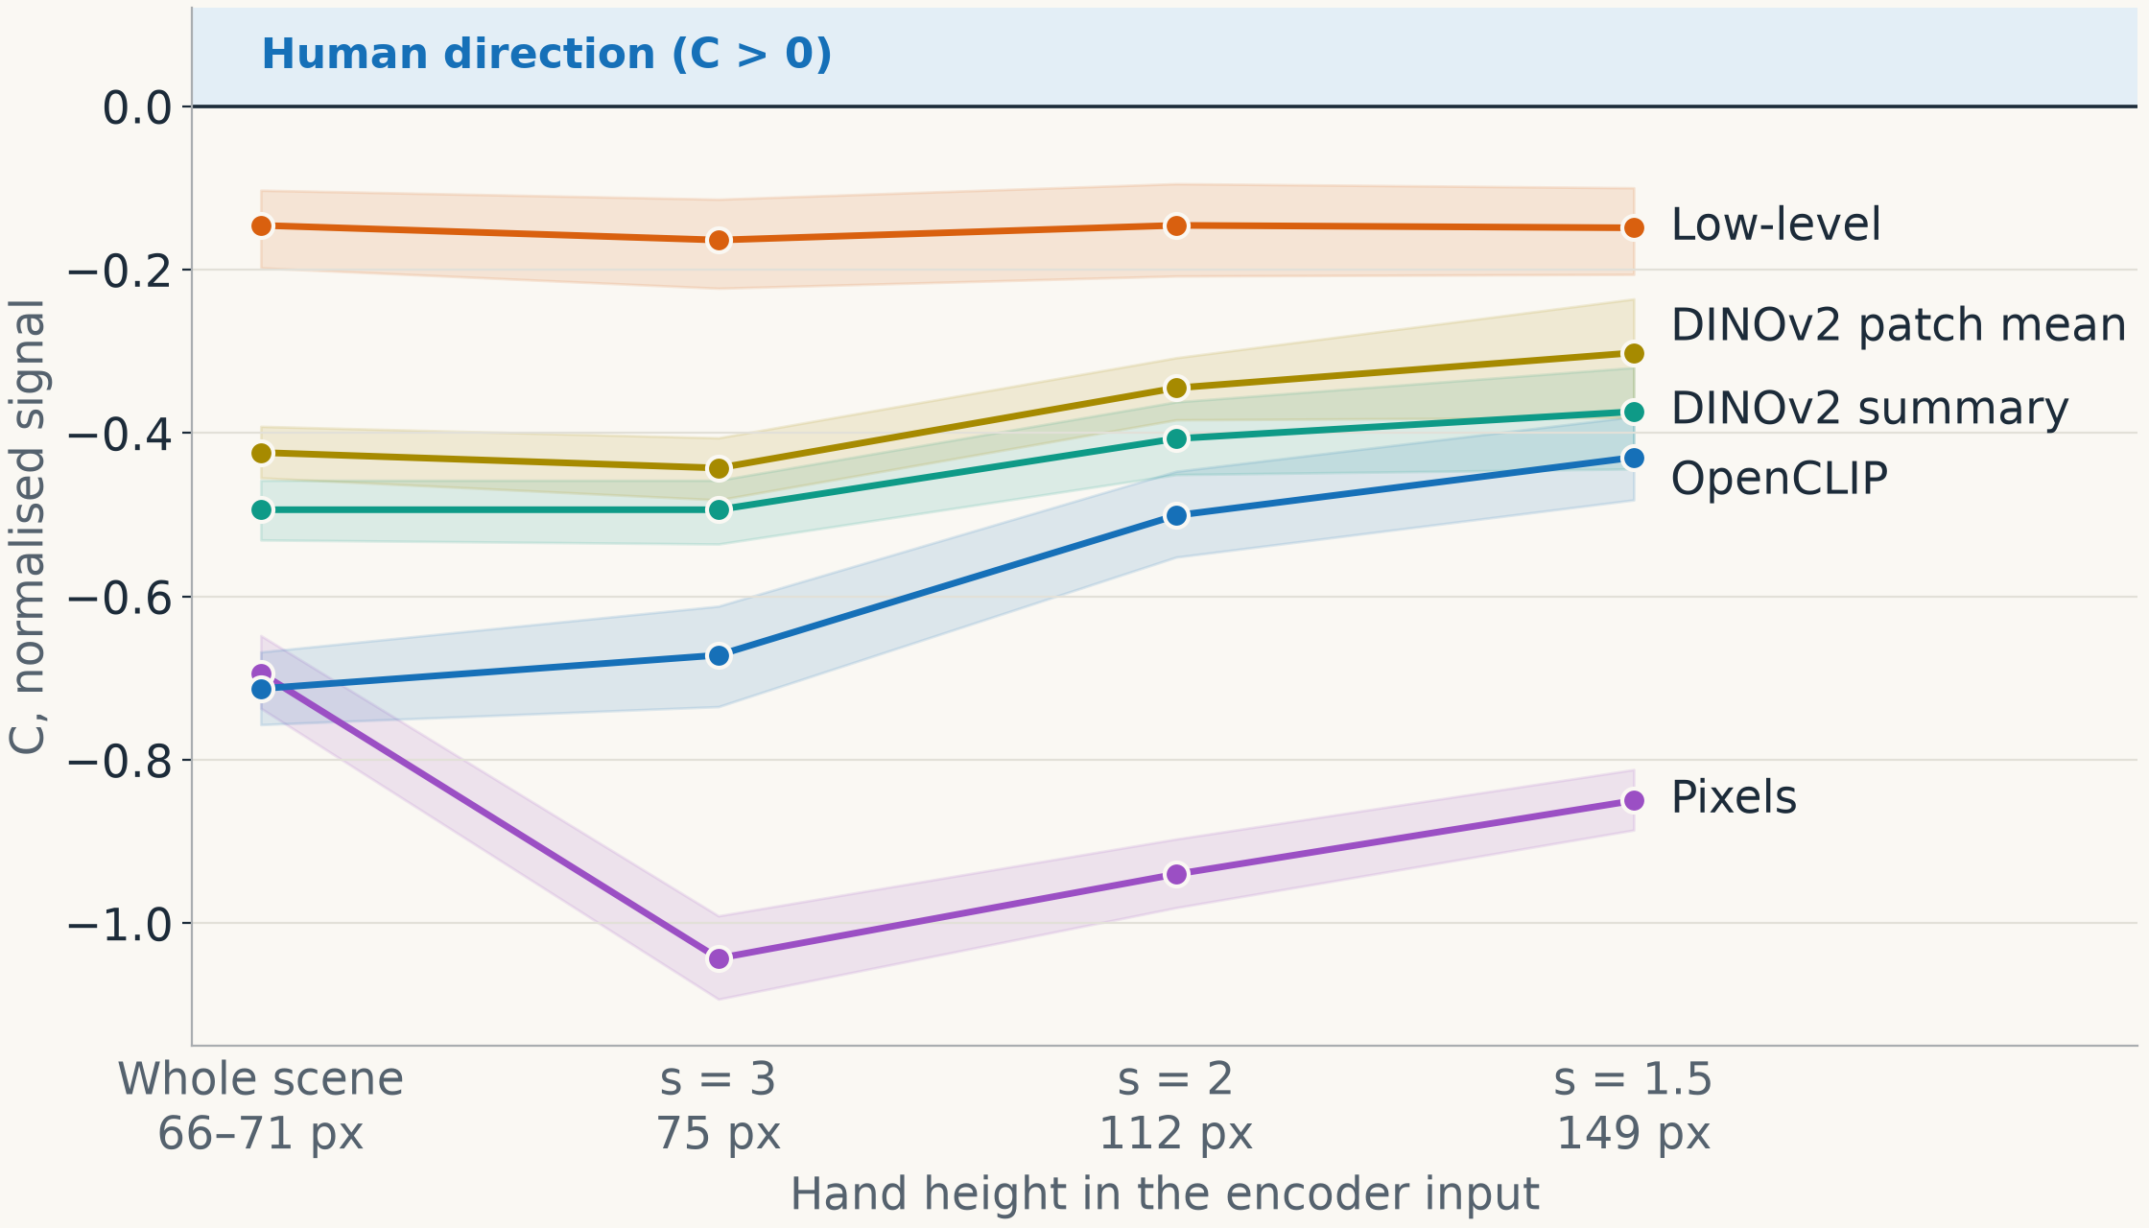
Zooming in on the hand shrinks the reversal but does not remove it
Gate 1 · Zooming in (extra test)
Why: the hand is only 66–71 pixels in the whole scene.
Test: 28,800 zoomed images, with the hand up to 149 pixels.
144 / 156
alternative analyses still reverse; 8 unclear, 4 positive
The 4 positive ones are all one model, on the rectangle, at the closest zoom.
Terms: C = connected signal minus detached signal; above 0 is the human direction. s = zoom scale; smaller means closer. Extra test = planned after Gate 1, before computing. Rectangle = detached hand with desk.
Addendum A. Source: baselines document
Notes:
A fair objection is that the hand is very small in these images, so maybe vision models cannot see it well. So we zoomed in. The reversal becomes smaller but stays. This test is extra: it was written after Gate 1, but before the numbers were computed. Details: scales 1.5, 2 and 3 give hands of 149, 112 and 75 pixels. At s = 1.5 the detached-to-connected ratio is 2.3 to 4.8. The 4 positive cells are DINOv2 patch mean, rectangle, s = 1.5, raw and cosine, with and without reference 17. In the two closest zooms, full-body and upper-limb crops are identical. Features were bit-identical on two GPUs.

Slide 47
The vision models do not offer a general “attached” signal
Gate 1 · Attachment in the features
We train a simple decoder to tell connected from disconnected in one matched pair, then test it on the other pair.
Representation | Stub → window | Window → stub
Pixels | 1.00 | 0.90
DINOv2 patch mean | 0.80 | 0.86
DINOv2 summary | 0.58 | 0.66
OpenCLIP | 0.24 | 0.18
A decoder trained on full body and upper limb vs detached hand also fails on the stub pair: 0.00–0.45.
Conclusion: attachment is not available off the shelf. Nothing carries over beyond pixel layout: pixels transfer best, and OpenCLIP falls below chance.
Terms: Decoder = a simple classifier that reads a property from the numbers. Stub, window = the two matched pairs. DINOv2, OpenCLIP = two such vision models.
Values: accuracy on the other pair; 0.50 is chance. Inside one pair, every decoder is perfect. Source: baselines document
Notes:
We asked if a vision model contains a usable connected-or-not signal. Inside one pair, decoders are perfect, but that could rely on any image detail. The real test is transfer to the other pair. Pixels transfer best, so what carries over is pixel layout. OpenCLIP is even below chance. So attachment is not available off the shelf. Details: representational similarity analysis gave partial correlations of only 0.07 to 0.11, and movement direction resembles full body only for upper limb, cosine about 0.5.

Slide 48
Gate 1 passed: visual change alone cannot explain the human effect
Gate 1 · Outcome
What it means
Limits
Passed on 23 October: the human pattern stays a clean target
A model must add something beyond visual change
The model must still pass our test against simple alternatives (S3)
20 synthetic sources
Two encoders only
A visual signal is not a motor response
Terms: Gate 1 = the first planned checkpoint. S3 = a later pass criterion. Clean target = not already explained by image change.
Source: validation; baselines document
Notes:
Conclusion: images alone do not explain the human effect, in fact they go the other way. So it makes sense to build a motor model. A model that works must add something beyond visual change. The limits are that this uses 20 synthetic hands and two vision models, and that a visual signal is not motor excitability.

Slide 49
The model
Section 5
How it is built · The rules we compare · Training · The virtual pulse · Repairs
Notes:
Now the model. We will see how it is built, which competing rules we test, how it learns, how we copy the magnetic pulse in simulation, and what needed to be repaired.

Slide 50
From an image to a simulated motor response
The model · How it is built
1
2
3
4
5
Image
Vision model
Visual layer
Gate g
Motor pools
The displayed frame, one at a time
OpenCLIP, 1,280 numbers; not trained
256 spiking neurons
Scales the signal to the motor layer
FDI 64 and ADM 64 neurons
Readout: a simulated pulse hits the motor neurons. We count spikes for 55 ms and subtract an identical run without the pulse. This plays the role of the MEP.
Why OpenCLIP: it was the least favourable vision model in Gate 1, so choosing it cannot help our hypothesis. DINOv2 is also run as a check, and so is a non-spiking copy of the network.
Terms: DINOv2, OpenCLIP = ready-made vision models. FDI = first dorsal interosseous, the muscle that moves the index finger. ADM = abductor digiti minimi, the muscle that moves the little finger. MEP = motor evoked potential, the muscle’s response to the pulse. Spike = a brief pulse from a neuron; our neurons are LIF: leaky integrate-and-fire.
A recurrent variant is planned but not yet built. Source: model-method document
Notes:
Follow the five boxes. An image goes through a vision model we do not train. Those numbers drive a layer of spiking neurons. Then the gate decides how much of the signal goes to the motor neurons. Every hypothesis is a different gate. To read the model we copy the experiment: give a pulse and count the response. Details: membrane time constant 20 ms, synaptic 5 ms, step 1 ms, built with snnTorch. Robustness encoders: DINOv2 summary 1,024 values and patch mean.

Slide 51
Each hypothesis is one rule for the gate
The model · The rules we compare
Model | Gate | In simple words
H0 hand only | g = 1 | The model sees only the hand
H1 salience | g = 1 + s / s̄ | More image change, more drive; nothing fitted
H2 continuity | g = c + (1 − c) a | Drive depends on the forearm joining at the wrist
Ungated | g = 1 | H2’s network with no gate: is the gate needed?
H2-learned | H2’s form, learned a | a is learned by predicting the forearm
H4 familiarity | H2’s form, new a | a is how typical the view looks
How c is set: one number, fitted on training sources to the human detached/full-body ratio (−0.10). No upper-limb data are used, and no model is told which display it sees.
Terms: g = gate. a = forearm continuity: 0 none, 1 connected. c = the gate’s one fitted number. s = image change; s̄ = its average. H = hypothesis.
Source: model-method document; analysis spec
Notes:
Keep it to the first three rows. H0: only the hand matters. H1: more visual change gives more drive. H2, our main hypothesis: the signal passes if a forearm visibly joins the hand at the wrist. The other rows are comparison models. Stress that the model never gets a label saying which display it sees. Detail: a is measured from SAM-HQ masks in palm widths, capped at 1.

Slide 52
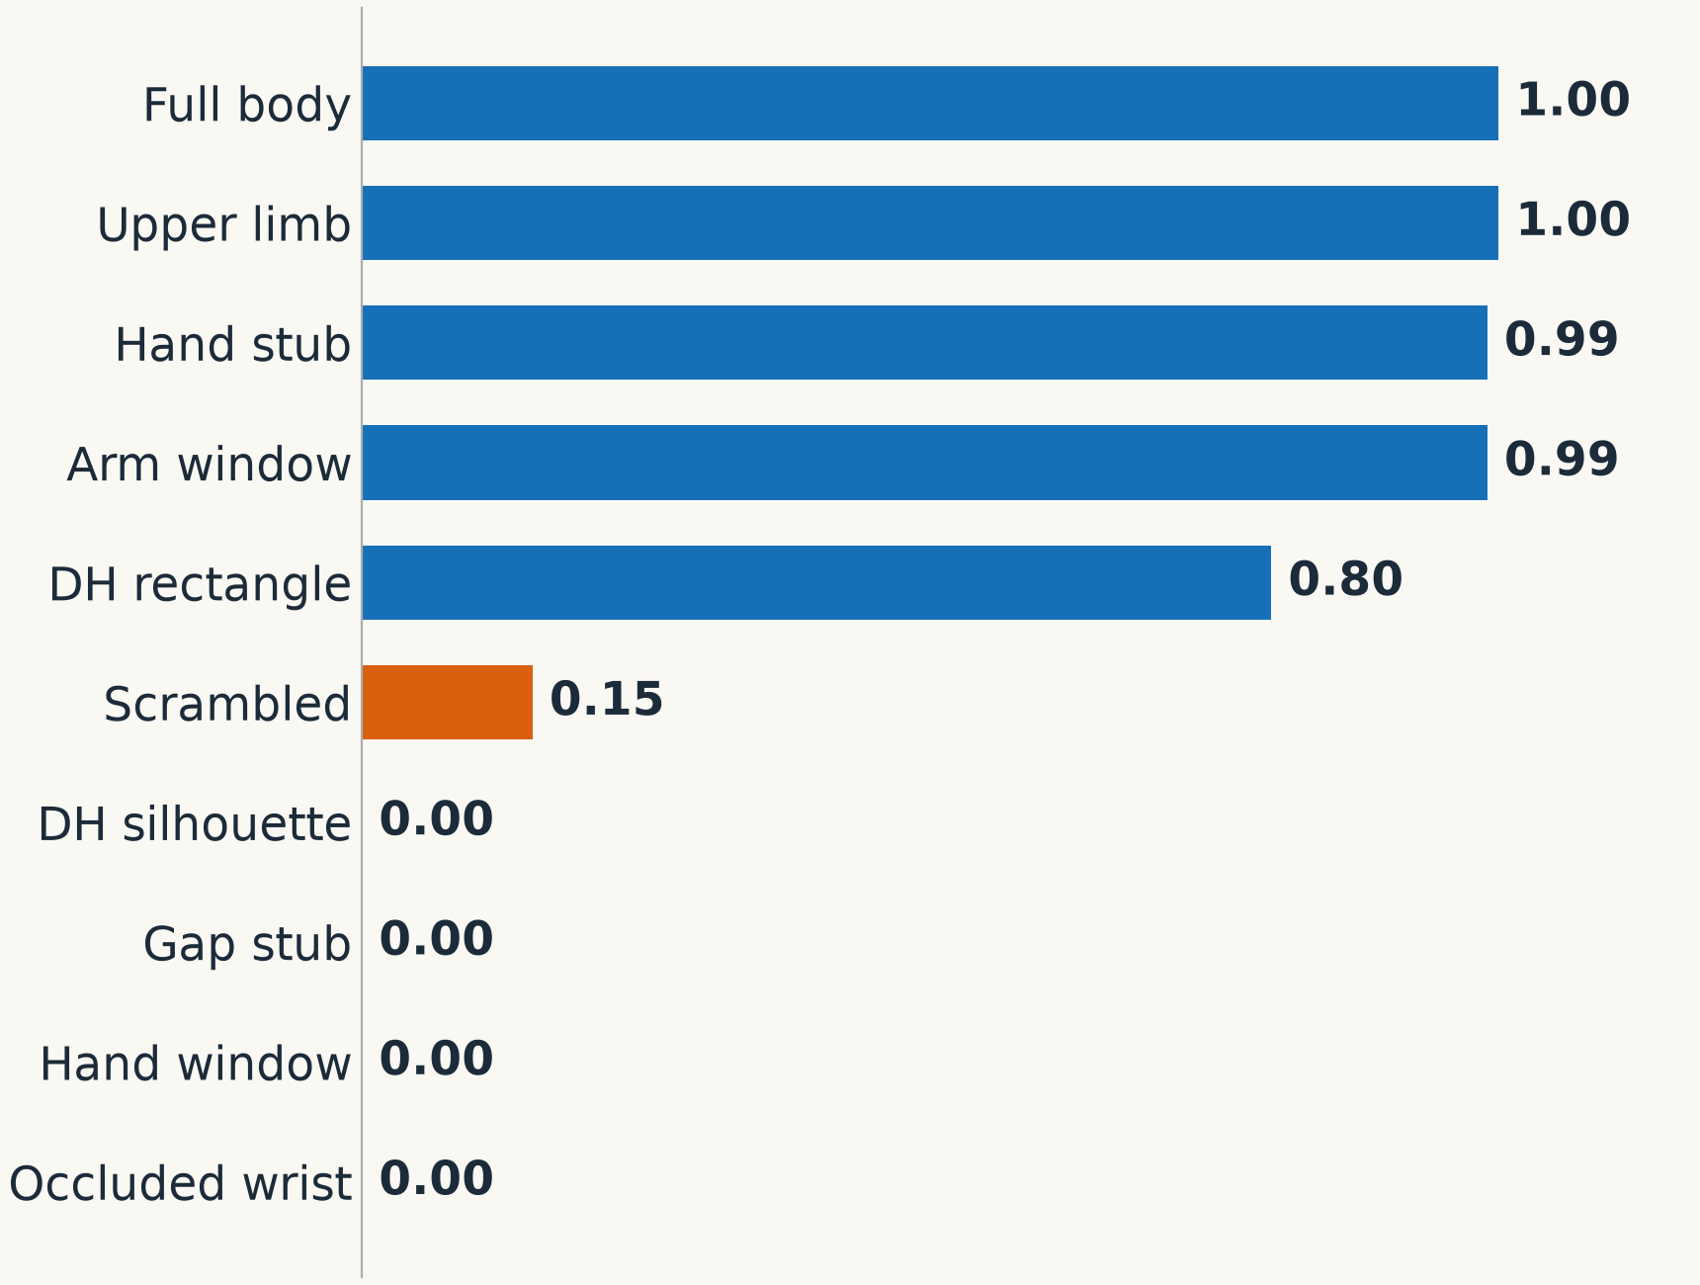
Continuity is measured from the image, per display
The model · The continuity value a
Connected displays get a value near 1, disconnected ones near 0.
The rectangle gets 0.80, because it shows some forearm. So H2 predicts it behaves close to the upper limb.
Terms: a = forearm continuity at the wrist, from 0 to 1. H2 = our main hypothesis. Rectangle = detached hand with a piece of desk.
Source: model-method document; output/model
Notes:
This is the value H2 uses for each display. It comes from the image, not from a label. Full body and upper limb get 1, a detached hand gets 0. Scrambled gets 0.15. An interesting case is the rectangle: the earlier detached hand shows 0.80 palm widths of forearm, so H2 predicts it should act like a connected hand. That is why the rectangle was not a clean detached hand.

Slide 53
Networks learn from full-body images, never from MEPs
The model · Training
Data
Task
Limit
Full-body displays from training sources only
Detect the index movement from the index-muscle (FDI) neurons
Motor neurons stay quiet: near 1 Hz at rest, at most 3 Hz in a trial. Watching, not doing.
Idea: people learn links between seeing and doing from watching their own actions. The task stands in for that learning. The human result is never a training target.
An assumption: ADM neurons are held equal, so muscle specificity is built in. ADM results are only exploratory.
Terms: MEP = motor evoked potential, the muscle’s response to the pulse. FDI = first dorsal interosseous, the muscle that moves the index finger. ADM = abductor digiti minimi, the muscle that moves the little finger. Hz = spikes per second. Exploratory = not part of the pass criteria.
Basis: Heyes 2001; Catmur et al. 2007; Cook et al. 2014. Source: model-method document
Notes:
An important point for credibility: the model is not trained to copy the human result. It learns only one small job, to detect finger movement in full-body images. Upper-limb and detached images are never seen in training. We then test what it does with them. Details: Adam optimiser, learning rate 10 to the minus 3, batch 32, 3,000 updates, 19 training sources.

Slide 54
The virtual pulse copies the human procedure, step by step
The model · The virtual pulse
1
2
3
Threshold at rest: smallest pulse giving at least 6 spikes in half of 40 trials
Set the pulse at 120% of that threshold
Deliver it at 250 ms
4
5
6
Count spikes over 0–55 ms, minus the same run without a pulse
Clean: remove extreme values, then rescale per network
Analyse with the same code as the human data
Terms: TMS = transcranial magnetic stimulation, the real magnetic pulse. Spike = a brief pulse from a neuron. Probe = the simulated pulse.
Threshold found by bisection. Source: model-method document
Notes:
Walk through the six steps. They mirror the human experiment: find the threshold, set the pulse at 120 percent, give it 250 milliseconds into the image, measure, clean the values, and analyse with the same code. Details: the threshold is found by bisection, extremes are beyond plus or minus 2 SD, and values are z-normalised within each network, as the paper did per participant.

Slide 55
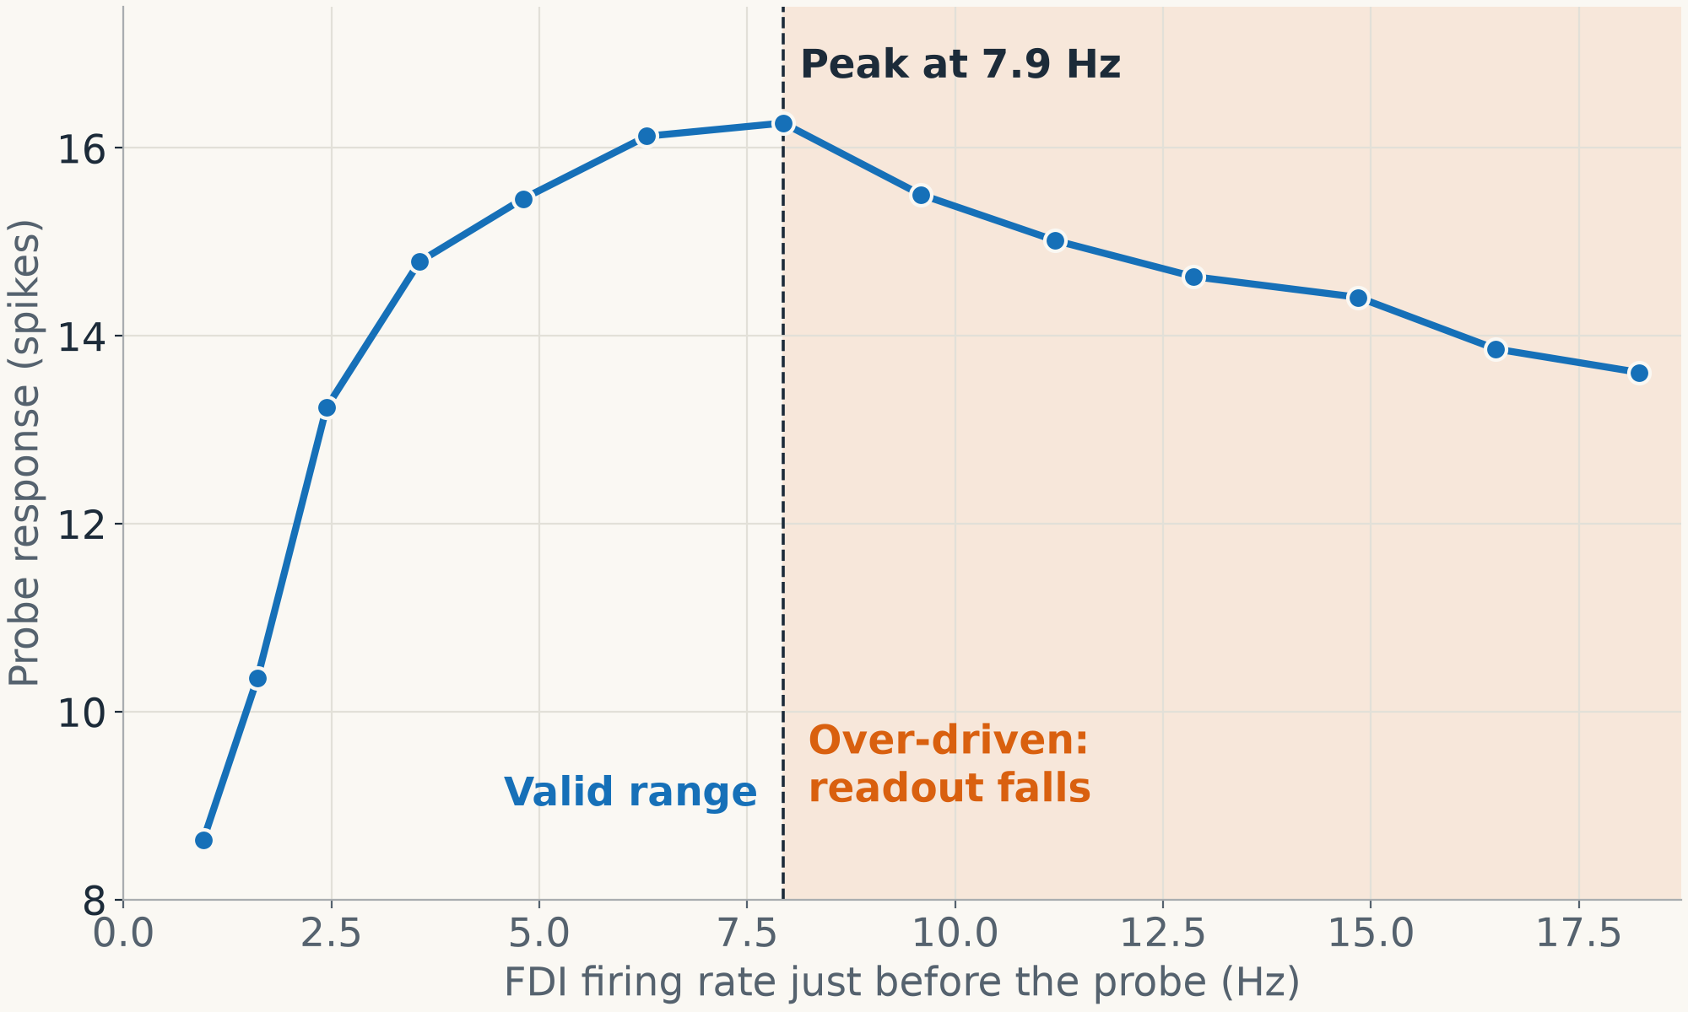
The model’s readout falls once the pool is over-driven
The model · The virtual pulse
In the model: the response peaks near 7.9 Hz of firing before the pulse, then falls.
In humans: the MEP rises and levels off. It does not fall.
This is a known model limitation. It is why over-driven networks need their own rule later.
Terms: Over-driven = firing past the peak. MEP = motor evoked potential, the muscle’s response to the pulse. Hz = spikes per second. Probe = the simulated pulse. Fold, seed = one data split and one random start.
Example: H2, OpenCLIP, fold 1, seed 0. Human curve: Devanne et al. 1997. Source: model-method document; output/model
Notes:
This chart shows a weakness of the model. If motor neurons already fire a lot before the pulse, the response goes down, because the pulse only shifts spikes in time and does not recruit new ones. Real muscles do not behave like this. So we must keep the model in the valid range on the left. Reference: Devanne et al. 1997.

Slide 56
The first version failed; two repairs fixed it on training data
The model · Repairs
Before
After
−0.47
+2.40 to +6.57
spikes, movement minus static. The index neurons fired at 26 Hz vs 5 Hz before the pulse, yet the response did not differ.
spikes in folds 1–4, all clearly above 0, on inner training sources. The ADM response stayed about the same.
Repair 1, observation without execution: hold motor activity near rest.
Repair 2, equal neurons in each pool: with separate weights, 12% fired above 10 Hz while half stayed silent.
Terms: ADM = abductor digiti minimi, the muscle that moves the little finger. Fold = one data split. Inner source = a training-side source set aside for checks. Pool = a group of motor neurons.
Source: model-method document
Notes:
In the first version the trained response was invisible to our readout, for the reason on the previous slide. The motor neurons fired too much. We fixed it in two steps: keep motor neurons near rest, and let all neurons in a pool share one weight. All this was on training data. Details: before, −0.47 with interval −1.32 to 0.38. After, by fold: +6.57 [5.65, 7.50], +2.40 [1.46, 3.33], +3.50 [2.83, 4.17], +6.48 [5.57, 7.39].

Slide 57
Other faults were found and fixed, all on training data
The model · Repairs
Fault | Fix
Raw units amplified inputs about 110-fold | Inputs normalised
A black rest image was unfamiliar: FDI fired at 45 Hz | Fixation display used as rest
The human 5–60 ms window cut through the spike bursts | Window changed to 0–55 ms
A limit on the batch average let sources reach 9 Hz | Limit applied to each trial
The non-spiking copy’s output function failed | Replaced with a mean-field rate
Test range too short for some non-spiking copies | Range extended
Spinal readout stage, tried | Not adopted: it saturated
Discipline: each fix addressed a training-side fault. None was tuned on results from the other displays or on held-out data.
Terms: FDI = first dorsal interosseous, the muscle that moves the index finger. Batch = a group of training trials. Mean-field rate = an average firing rate. Saturated = stopped responding to a stronger input.
Source: model-method document; validation; analysis spec amendment log
Notes:
No need to explain each row. The message is that checks found real faults and we fixed them, and that each fix was made using training data only, so the fixes cannot be bending the final result. Details: the window change moved the dose-response Spearman from 0.76 to 1.00. Twin ranges grew from 14.1 to 15.7 Hz when the sweep was extended to 0.6, so 20 twins were no longer over-driven. We also mirrored the paper’s ±2 SD trimming.

Slide 58
The training campaign
Section 6
Design · Speed · Health check · Failing networks and the rule for them
Notes:
With the model working, we trained all the networks. This section covers how many, how long, how many are healthy, and what we do about the ones that are not.

Slide 59
2,400 networks, each kept blind to one source
The training campaign · Design
12
× 20
× 10
= 2,400
model types: H2, H0, H1, H2 twin × 3 vision models
data splits: each source held out once
random starts
networks trained
Fold 1
H
C
Fold 2
H
C
Fold 3
H
C
… and so on, for 20 folds …
Fold 19
H
C
Fold 20
C
H
H = held out, never used · C = inner check source · gray = 18 training sources
Terms: Twin = a non-spiking copy of the network. Fold = one data split. Inner check source = set aside to check training. Held-out = kept aside, never used in training.
Schematic: the position of C is illustrative. Source: analysis spec; validation
Notes:
The multiplication is the design: 12 model types, 20 data splits, 10 random starts, 2,400 networks. Look at the grid: in each row, one source, marked H, is never seen, one source, marked C, is used to check training, and the 18 gray ones are used for training. So each network is later tested on a hand it has never seen.

Slide 60
Training many networks at once made this possible
The training campaign · Speed
≈ 9 ×
≤ 6×10⁻⁸
0
faster: 0.41 s per update alone, 0.032 s per network in a group of 17
largest difference from training a network alone: practically none
networks that failed to run
Where: six GPUs on the CREMI lab computers.
When: 25 October 01:55 to 26 October 16:27.
One at a time would have needed about 1,000 GPU hours (estimate).
Terms: GPU = graphics processing unit, the chip used for training. CREMI = the University of Bordeaux lab computers. Weight = a learned connection strength.
Source: validation; model-method document
Notes:
Training one network at a time would have taken about 1,000 GPU hours, so we trained them in groups, about nine times faster. We tested that a network trained in a group ends up practically the same as one trained alone. The run took about a day and a half. The machines were jessica, daniel, joe, vladimir, moneo and cheonech. The weight test was after 20 updates.

Slide 61
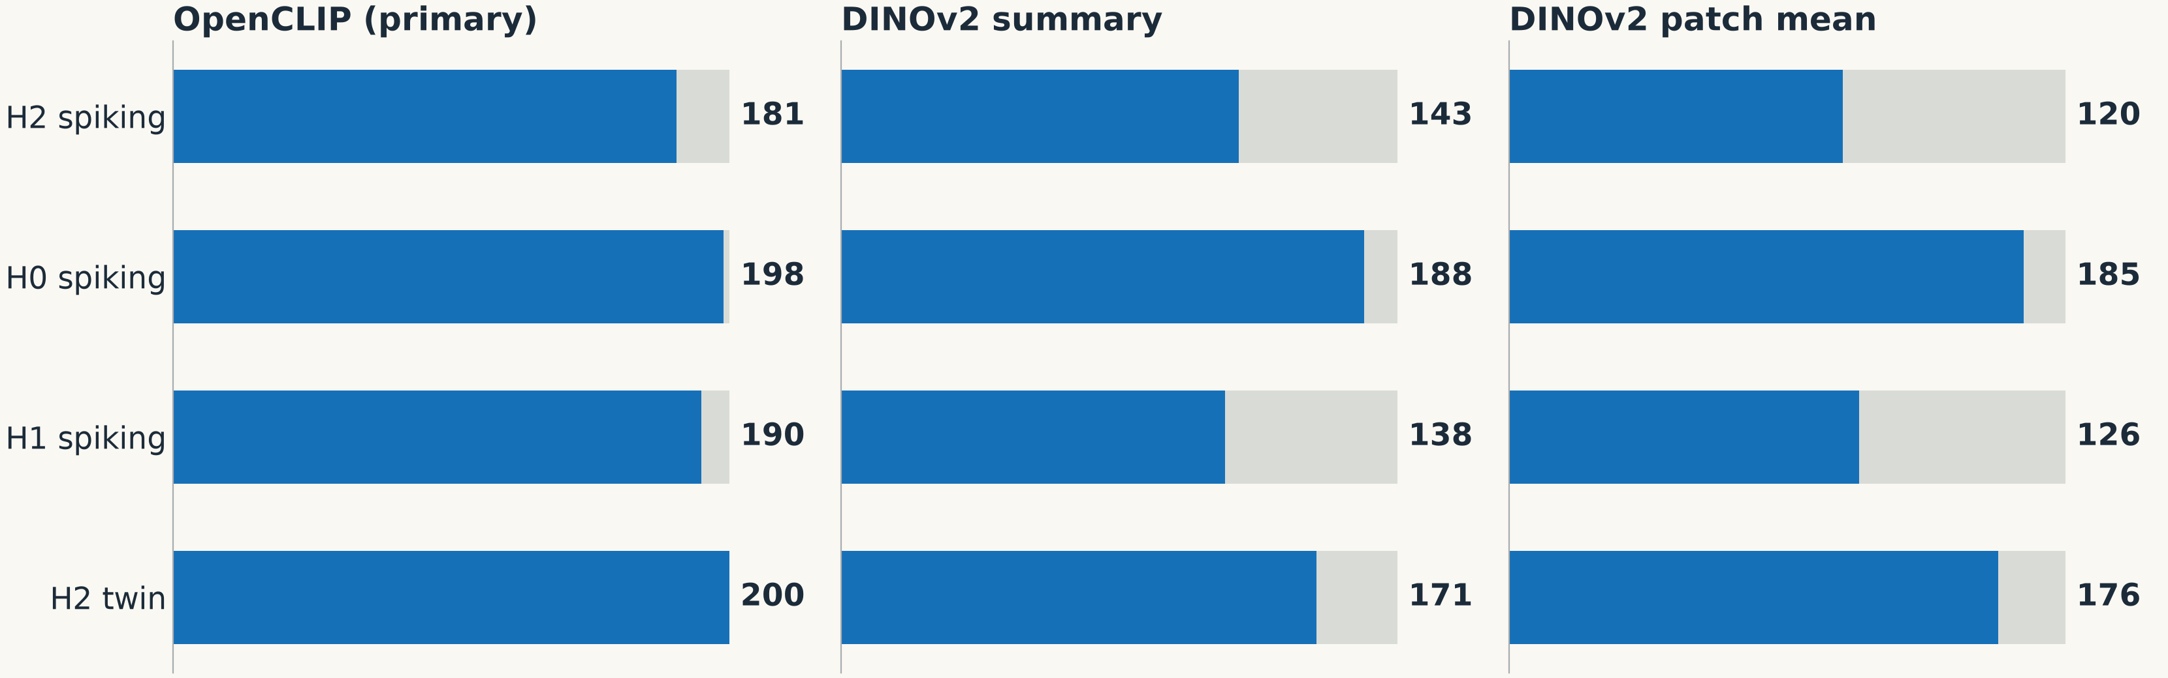
2,016 of 2,400 networks pass every health criterion
The training campaign · Health check
Only three checks ever fail: task, facilitation and background firing. All others pass in all 2,400 networks.
Terms: H0, H1, H2 = the hypotheses. Twin = non-spiking copy. Facilitation = a larger response to movement. Background = firing before the pulse.
Bars count passing networks out of 200 per model type. Training-side data only. Source: validation; output/model
Notes:
A health check asks whether a network behaves sensibly, not whether it matches humans. Blue is passing, gray is failing, out of 200 in each row. 2,016 of 2,400 pass everything. OpenCLIP, our main vision model, does best. No human comparison has been made here.

Slide 62
The 384 failures depend on the data split, not the random start
The training campaign · Failing networks
214
145
25
Over-driven
No transfer
Facilitation only
Index neurons fire at 8–24 Hz on the inner source (healthy: 1.6–3.1)
Neurons stay at rest (about 0.95 Hz), so the task fails (AUC below 0.9)
Only this check fails
Where a split fails, most random starts fail: 367 of 404 failures (91%, before the later recount to 384) are in splits where at least 5 of 10 starts fail.
What we cannot say: whether the inner source or the split’s training images cause this. No setting was changed in response.
Terms: Inner source = the source set aside to check training. Over-driven = firing past the peak. AUC = area under the curve: 0.5 chance, 1 perfect. Hz = spikes per second.
Source: model-method §6.16–6.17
Notes:
There are two main kinds of failure, and they are two sides of one limit: the learned drive does not carry over at the right strength to a hand the network has not seen. Sometimes it is too strong, over-driven. Sometimes it is too weak, no transfer. We did not change any setting because of this. The numbers: 214 plus 145 plus 25 equals 384.

Slide 63
A rule fixed before evaluation stops failures from favouring a hypothesis
The training campaign · The rule
Failure of the network itself
Failure only on some sources
Would be excluded. None occurred.
The network stays in and the failure is reported per network.
Over-driven held-out displays are analysed in two ways:
Criterion met
Not met
Undetermined
only if both ways pass
if both ways fail
otherwise; never counts in favour
Terms: Over-driven = firing past the peak, where the readout falls. Held-out = kept aside, never used in training. Criterion = a pass test.
Way 1: remove the display. Way 2: give it the highest possible readout. After Horowitz & Manski 2000. Source: analysis spec §5.1
Notes:
The problem: a too-active network reads as low, and that could accidentally help or hurt a hypothesis. So we analyse those cases in two ways. A criterion counts as met only if it passes both ways. If the two ways disagree, the result is undetermined, and that never counts in favour of the hypothesis. The rule was fixed before any evaluation, and its assumptions were tested on all 2,400 networks.

Slide 64
Learned gates did not reproduce the continuity rule
The training campaign · Learned gates
Display | Rule a | H2-learned | H4 (OpenCLIP)
Full body | 1.00 | .69 | .68
Upper limb | 1.00 | .69 | .15
Detached hand | 0 | 0 | 0
Rectangle | .80 | 0 | .01
Hand stub | .99 | 0 | 0
Arm window | .99 | .01 | .01
H2-learned rejects the stub, so it does not isolate attachment. Expected to fail the matched-pair test, S3(a).
H4 treats upper limb very differently from full body. Expected to fail the ratio test, S2.
Terms: Rule a = continuity measured from the image. H2-learned = a learned by predicting the forearm. H4 = a from how typical the view looks. S2, S3 = later pass tests. OpenCLIP = a vision model.
Definitions were not changed afterwards. Source: analysis spec; model-method document
Notes:
We asked if a gate could be learned from images, instead of us defining it by hand. Compare the columns: the left is our rule. H2-learned gives full body and upper limb 0.69, but about 0 to the connected stub and arm window. H4 gives upper limb only 0.15. So neither learned gate captures attachment in general. We did not change their definitions after seeing this.

Slide 65
The evaluation code is written and tested, but not yet run
The training campaign · Evaluation code
evaluate.py
criteria.py
Runs the simulated pulse. Refuses held-out data unless explicitly opened.
Computes the pass tests we declared.
fit_gate.py
gate2.py
Finds the best gate number c by trying 21 values from 0 to 1.
Runs the Gate 2 checks.
Tested on made-up test data only. As recorded, none of this has run on the trained networks, so there is no model result yet.
Terms: Gate 2 = the next checkpoint. c = the gate’s one fitted number. Held-out = images kept aside. .py = a Python program file.
Source: validation; commit 3c280cd
Notes:
We have written the programs for the coming steps, and tested them on made-up data so we know they work. They have not been run on the trained networks, as recorded up to 26 October. A safety feature: the evaluation program refuses to touch the held-out images unless opened on purpose. Detail: trial-wise and continuous simulation agree 100 of 100 without noise, and no cell differs with noise.

Slide 66
Where we stand
Section 7
Success criteria · What is built in · Decision audit · Status · Next steps
Notes:
To finish: what counts as success, how far we can trust a positive result, what is done, and what comes next.

Slide 67
What a model must do to count as a success
Where we stand · Success criteria
Test | Requirement
P1 | CFDI above 0, and its likely range excludes 0
P2 | Larger response to movement in both full body and upper limb
P3 | CFDI positive in at least 80% of random starts
S1 | Detached/connected ratio inside the human range [−0.67, 0.38]
S2 | Upper-limb/full-body ratio inside the human range [0.34, 1.78]
S3(a) | Beats a model based on visible area, on both matched pairs
S3(b) | Beats the hand-only model H0
Also required: P1 in the same direction with both DINOv2 versions.
Terms: P = main tests. S = supporting tests. CFDI = the contrast in the index muscle (FDI): connected minus detached. H0 = hand-only model. DINOv2 = another vision model. Held-out = kept aside, never used in training.
All tested with the main vision model, OpenCLIP, on held-out sources. Source: analysis spec §5.2
Notes:
These are the tests we fixed in advance. P1 to P3 ask if the main effect exists and is stable. S1 and S2 ask if its size is like the human one. S3 asks if the model beats simpler explanations. If the main model fails P1, we report a negative result. Detail: P2 requires each interval to exclude 0, and the spec table gives the full wording of S3.

Slide 68
For H2, some tests are nearly guaranteed; others really test it
Where we stand · Honest reading
Close to built in
Really informative
P2 for full body
P1, the main effect
S1, the detached ratio
S3(b), beating the hand-only model
P2 for upper limb
S2, S3(a) and P3
Agreement across vision models
Comparison with the ungated model, H0 and H1
Success would not show how such a signal arises from vision, or that humans use continuity rather than visible context.
Terms: Built in = follows from how H2 is designed. H0, H1, H2 = the hypotheses; H2 is the continuity gate. P, S = main and supporting tests. Ungated = no gate.
Source: decision audit; analysis spec
Notes:
This is the honest reading. H2 is told about forearm continuity, so it will almost surely make the detached hand weaker. Passing those tests says little. The real evidence is in the right box, for example whether upper limb behaves like full body. And even a full pass does not tell us how the brain computes this.

Slide 69
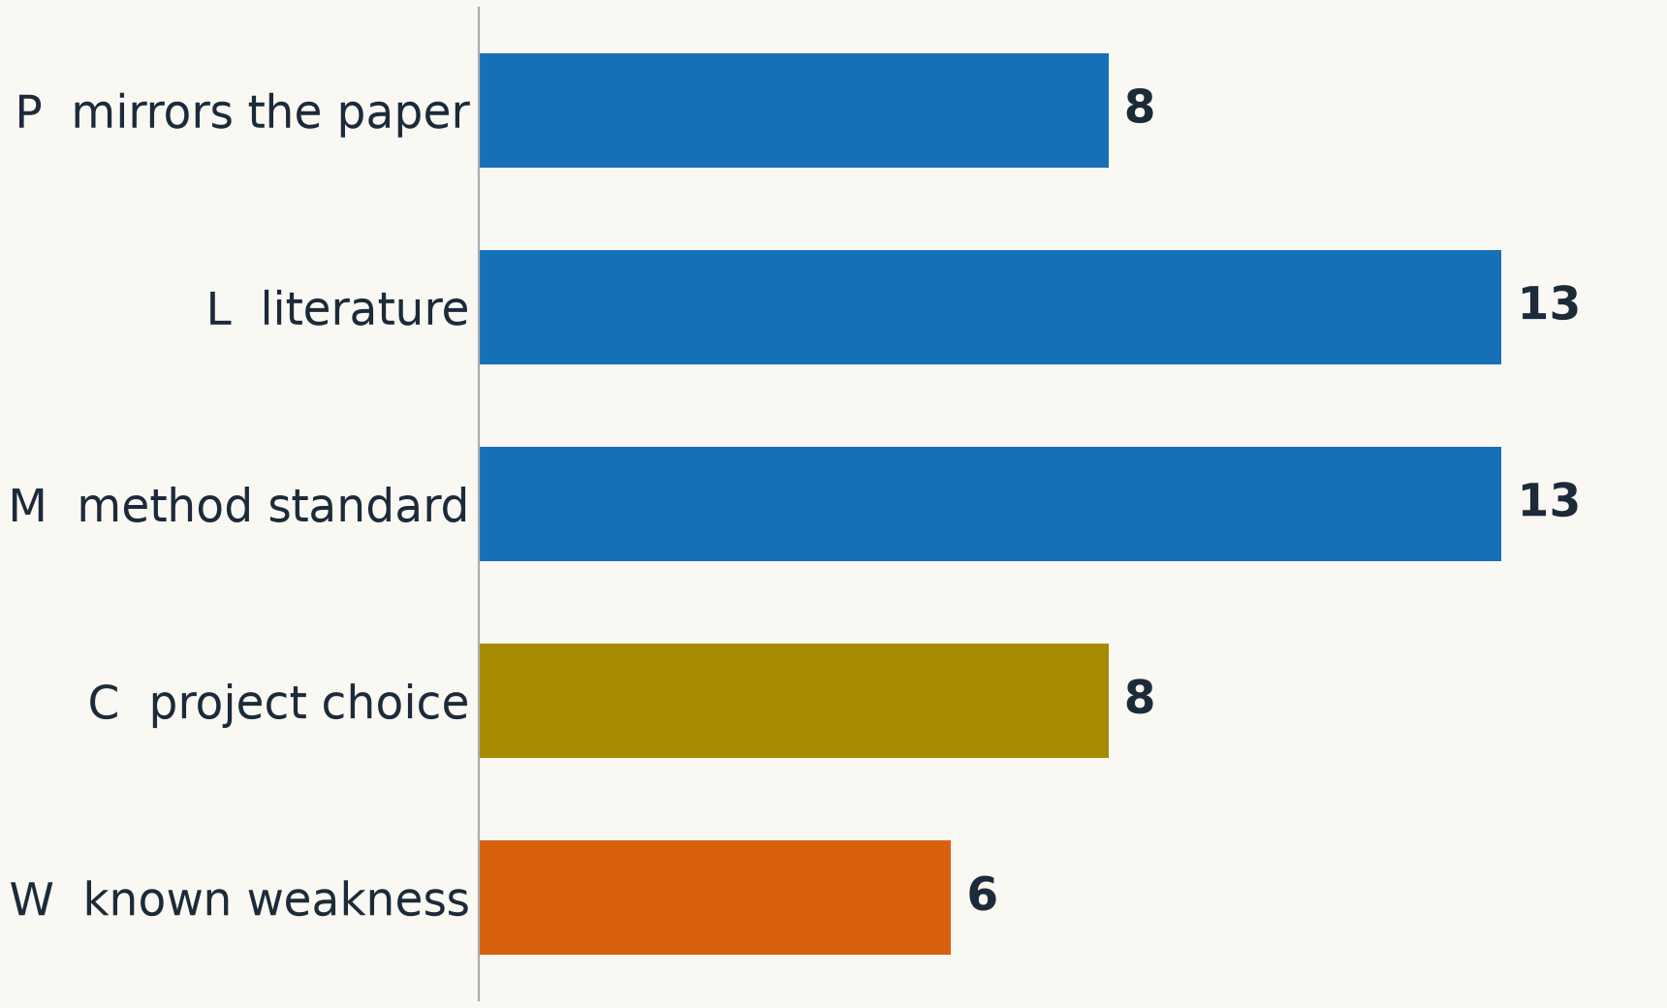
Major decisions were reviewed, and weaknesses are written down
Where we stand · Decision audit
48 decisions classified; 30 references verified.
Main weaknesses
20 synthetic sources
One unblinded reviewer
Tests P1 and S1 nearly guaranteed
Readout falls when firing is too high
No working spinal stage in the model
Terms: P1, S1 = two pass tests. In the chart: P = mirrors the paper. L = from literature. M = method standard. C = project choice. W = known weakness. Spinal stage = a spinal-cord step in the readout.
Source: decision audit
Notes:
We listed 48 decisions and asked for each one where it comes from: the paper, the literature, a method standard, our own choice, or a known weakness. We also verified 30 references. The right side lists the weaknesses you should know about. Better that you hear them from me now.

Slide 70
Training is done; the model has not been evaluated yet
Where we stand · Status
Done
Built, not run
Not done
Images and control displays
Human target re-analysis
Gate 1
2,400 networks trained
Failing-network rule
Criteria code
Fit of c
Gate 2 checks
Recurrent variant
Robustness variations
Ablations
Held-out evaluation
Robustness variations still to declare: other layer sizes, learning rates, training length, time constants and time step.
Terms: Recurrent variant = a model with connections inside the visual layer. Ablation = removing a part to see if it is needed. Robustness = same result with other settings.
As recorded up to 26 October 2026 (commit 3c280cd). Source: validation; next-phase plan
Notes:
Read the three columns. Done: images, human target, Gate 1, training. Built but not run: the code for the next stage. Not done: the recurrent model, robustness runs, ablations and the final test. This is as recorded up to 26 October. Details of the variations: visual layer 128 or 512, learning rate 3 × 10⁻⁴ or 3 × 10⁻³, 6,000 updates, different time constants, 0.5 ms step.

Slide 71
From here to the report
Where we stand · Next steps
Now
4 Dec
7–11 Dec
14–18 Dec
January
Fit c, run Gate 2 checks, build the recurrent model, run robustness
Gate 2: stable activity, smooth pulse response, and H0, H1, H2 differ
Ablations; model settings frozen on 11 Dec
Single evaluation on held-out sources
Report
If Gate 2 fails: simplify the model and report the negative result.
Throughout: every analysis is repeated without reference 17.
Terms: c = the gate’s fitted number. H0, H1, H2 = the hypotheses. Gate 2 = the next checkpoint. Ablation = removing a part to see if it is needed. Held-out = images never used in training.
Source: next-phase plan; analysis spec
Notes:
Keep this general. Next we finish preparing the model. Gate 2 on 4 December checks that it is stable and that the hypotheses really differ. If not, we simplify the model and report that negative result. Then ablations, freeze everything on 11 December, and run the single final test on 14 to 18 December. The report follows in January.

Slide 72
Everything is ready to test the model; no result exists yet
Summary
Images: synthetic, controlled, with matched controls for attachment
Human target: reproduced from the paper’s data; main effect = 0.283 [0.147, 0.419]
Gate 1: vision models reverse the human pattern (0 of 20 sources positive)
Model: 2,400 networks trained, 2,016 fully healthy
Next: Gate 2 on 4 December, one held-out evaluation 14–18 December
Notes:
Finish with one sentence per line. Images: controlled and checked. Human target: reproduced, with one main number. Gate 1: vision models alone go the opposite way. Model: trained, with 2,016 of 2,400 networks fully healthy. Next: Gate 2 and one final test. End by repeating that there is no result yet on whether the model matches humans, then invite questions.

